Slide 2
Who accesses phonics?
Any pupil who has a reading age of below ARE for year 2.
Those who are beyond Phase 6 (those who can read fluently beyond Age Related Expectations for Y3, can move beyond phonics and work on grammar and spelling patterns.
Phonics is a statutory requirement!

Slide 3
What?
What are we using?
At Springfield we are following the program ‘Bug Club’ a Systematic Synthetic Phonics approach but for some children we use Attention Autism as a method of access.

Slide 4
When?
Phonics should be done daily.
It should last 20-25 minutes

Slide 5
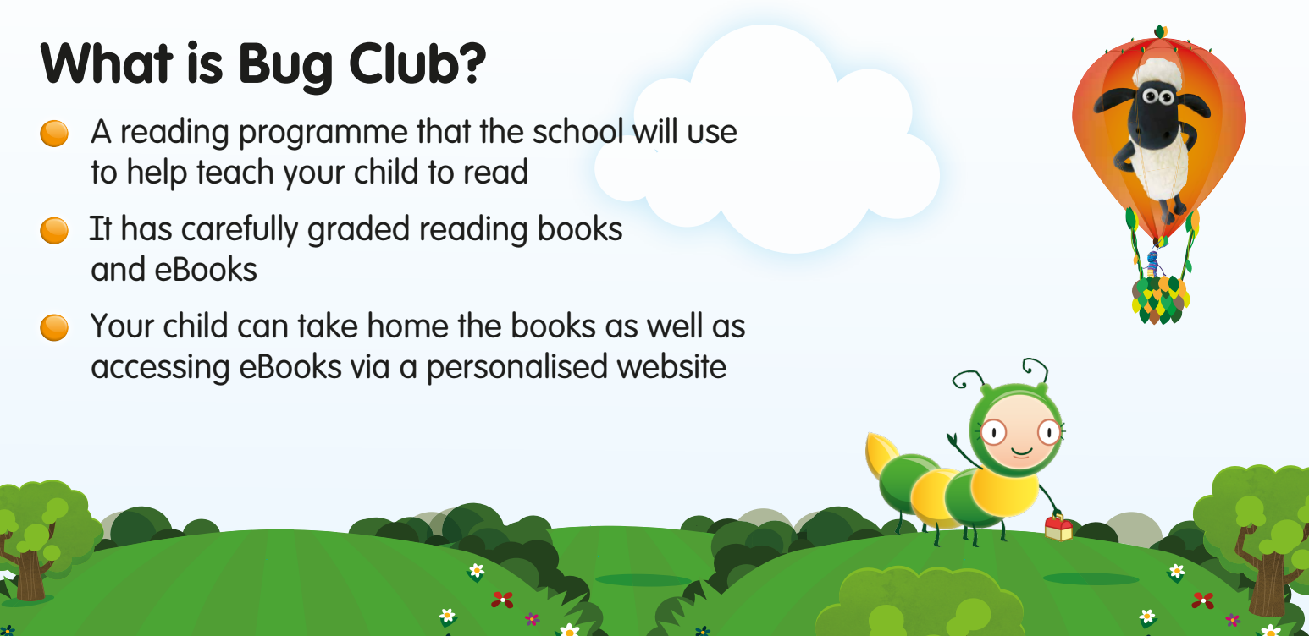

Slide 6
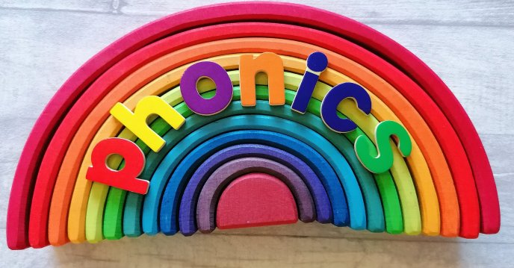
So let’s remind ourselves of the phases………

Slide 7
Phase 1
Phase 1 takes on a different format to Phase 2 upwards.
Phase 1 is about the processing of sounds and the recognition of what they are.
Check out the Phase 1 information in the framework for letters and sounds.
At Springfield we use Attention Autism to access Phase 1 into Phase 2.

Slide 8
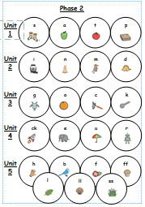
Phase 2

Slide 9
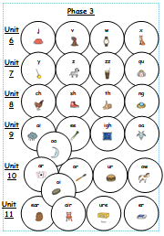
Phase 3

Slide 10
Phase 4
Review of Phase 3.
Begin read words that contain multiple grapheme-phoneme correspondences (GPCs) from Phase 3.

Slide 11
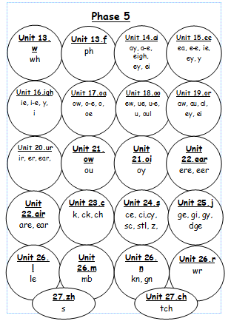
Phase 5

Slide 12
Phase 6
In Phase 6 Phonics the main aim for children is to develop their fluency as a reader and increase their accuracy when spelling.
They will have already learnt the most often used grapheme-phoneme correspondences (GPCs) in the English language.
Children will be able to sight-read a large number of words. When coming across an unfamiliar word, they have a range of strategies to decode them including their sounding and blending skills.

Slide 13
So what does a lesson look like?
At Springfield we follow the-
Review
Teach
Practice
Apply
Model. Here this ensures that lessons are structured and learning is sequential.

Slide 14
What about Reading
The recommendation for pupils working at a primary level-
All pupils should have a reading book; either personalised or a reading scheme book.
There should be a daily allocation on timetables for reading.
All pupils should read 2-3 times per week.
All reading books should go home daily.
Reading books need to be match to phonic phase. We say that children should be able to read 90% of the book.
In school we have Bug Club and Oxford Reading Tree. You should find guidance in your packs on matching books to phases. Bug Club should be used in the first instance.

Slide 15
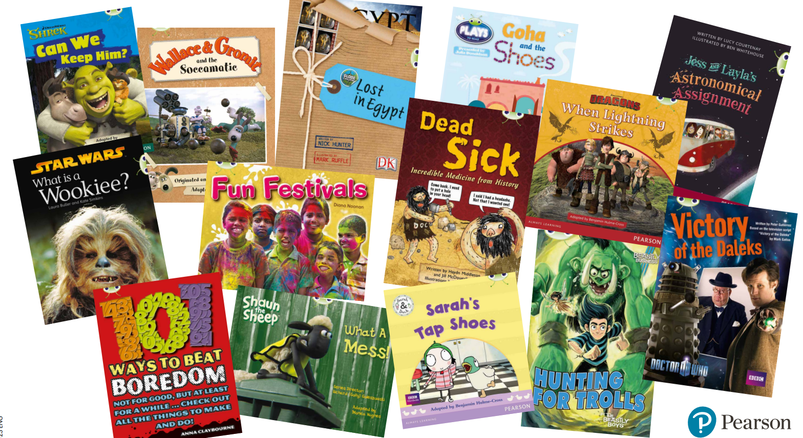

Slide 18
Glossary of Terms
Phoneme: The unit of sound that we hear the letters make in their shortest form.
Grapheme: The letter or letters that we see that make a sound in their shortest form.
Digraph: Two letters that make one sound. (We like to think of these letters as friends!) These can sit next to each other or be split.

Slide 19
Assessment
Your child should be assessed formally half termly for phonics using Bug Club.

