Slide 1
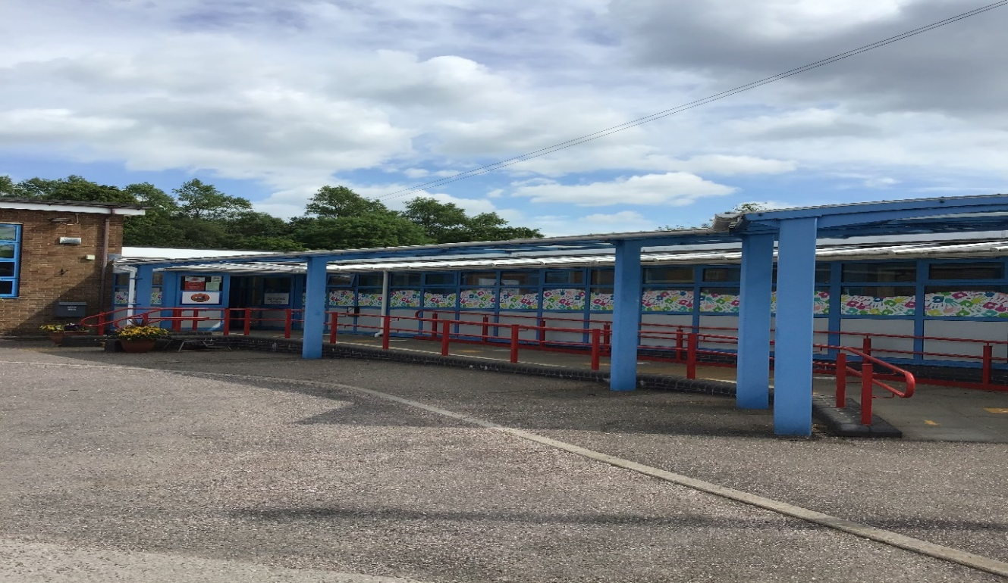
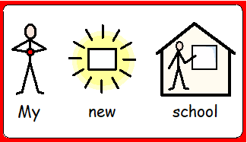
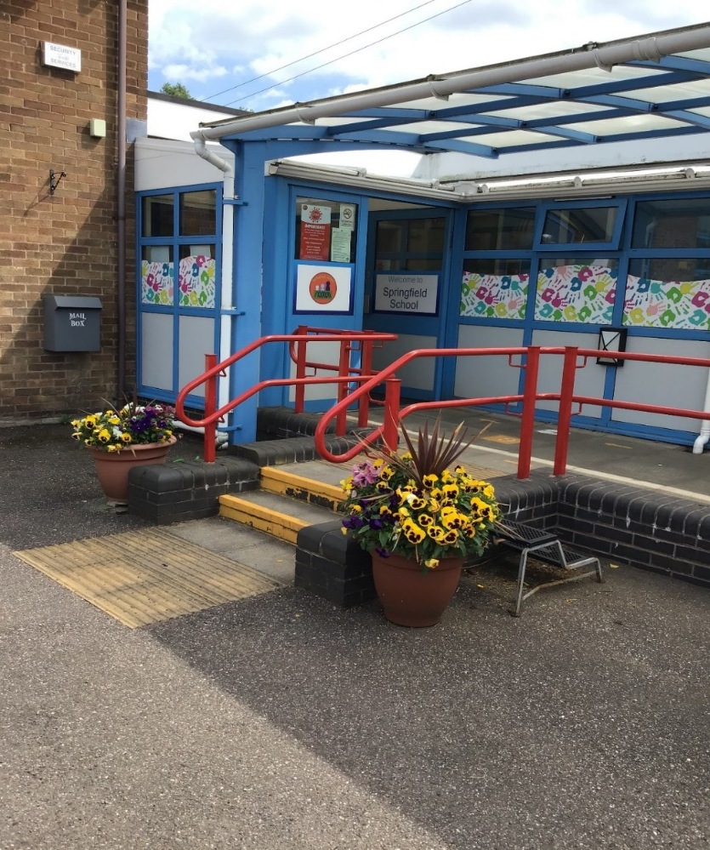
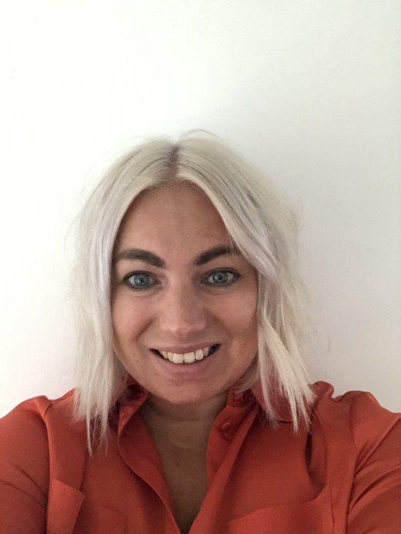
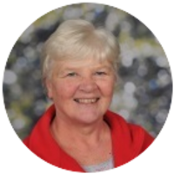
Welcome to Springfield School!
I am Helen- Blackbirds Class Teacher and also the Deputy Headteacher so I will be in class Tuesday, Wednesday and Thursday.
I am Louise, I will be teaching in Blackbirds Class Monday and Friday.

Slide 2
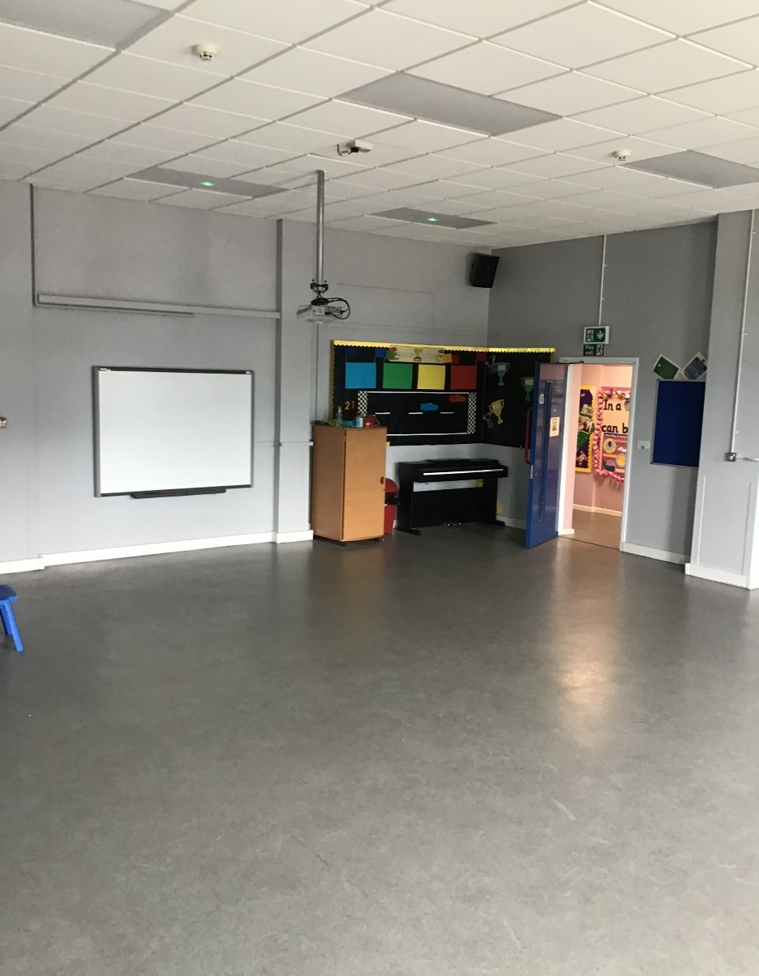
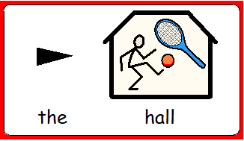
Here is our main reception and the hall. We have our PE sessions in the hall one day per week unless the weather is sunny, then we use our MUGA.

Slide 3
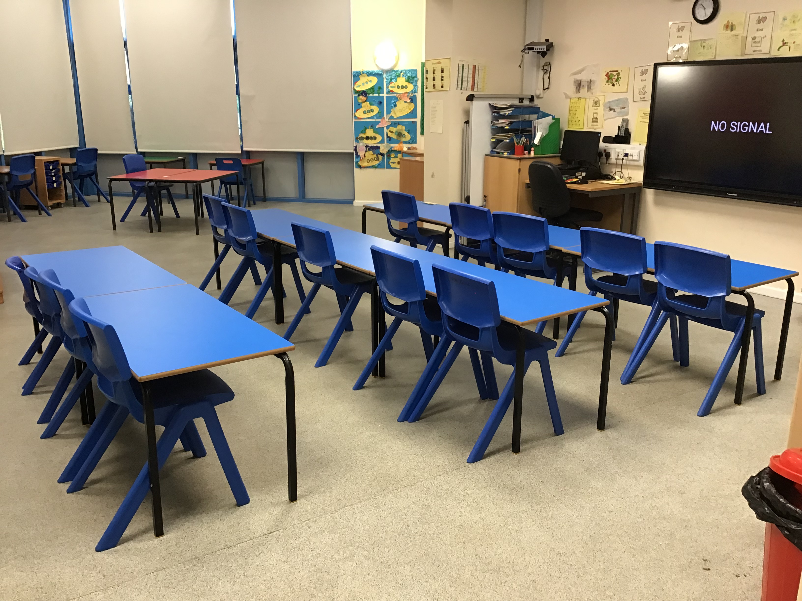
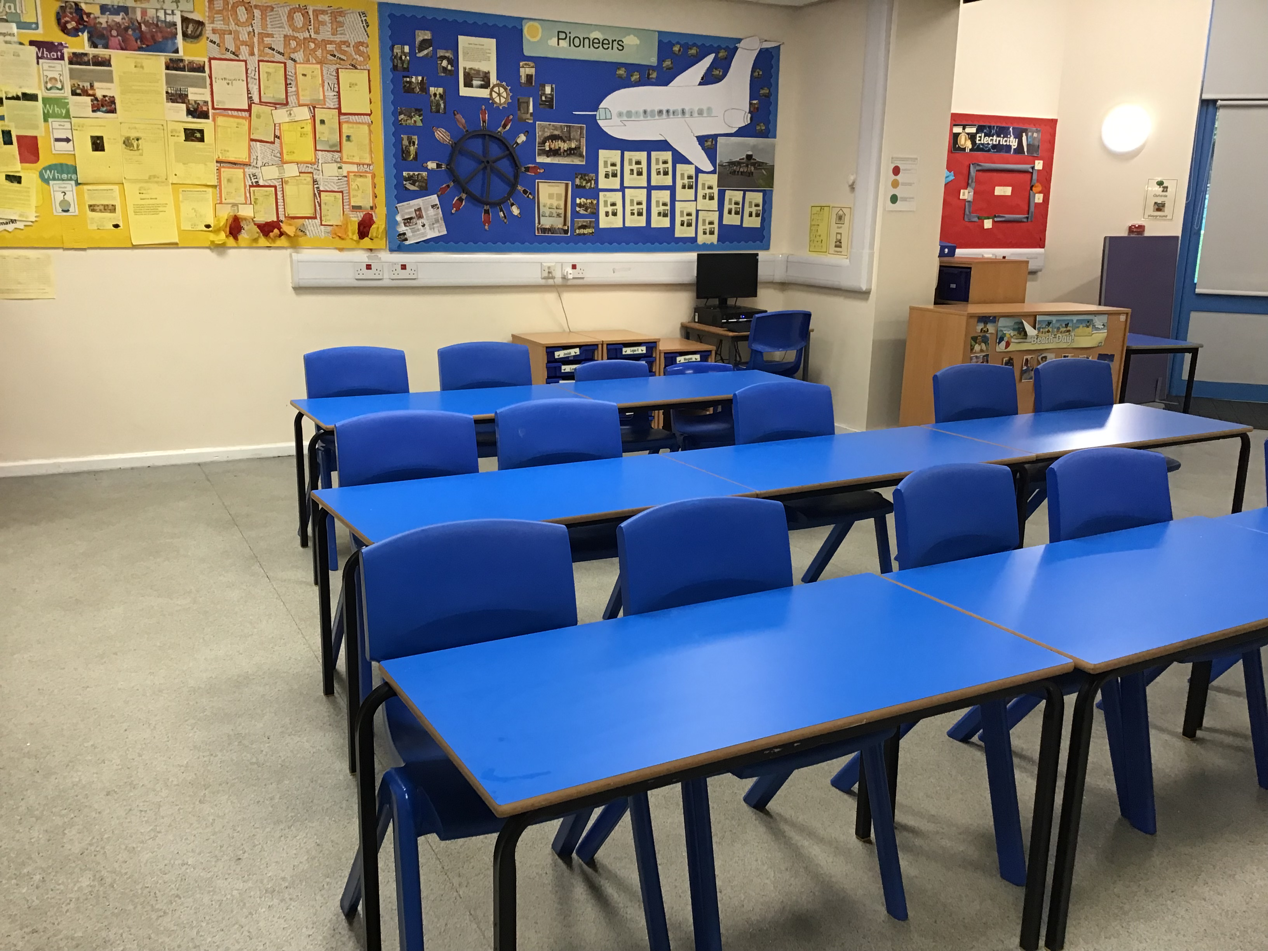
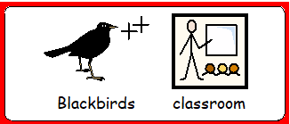
This is Blackbirds’ classroom.

Slide 4
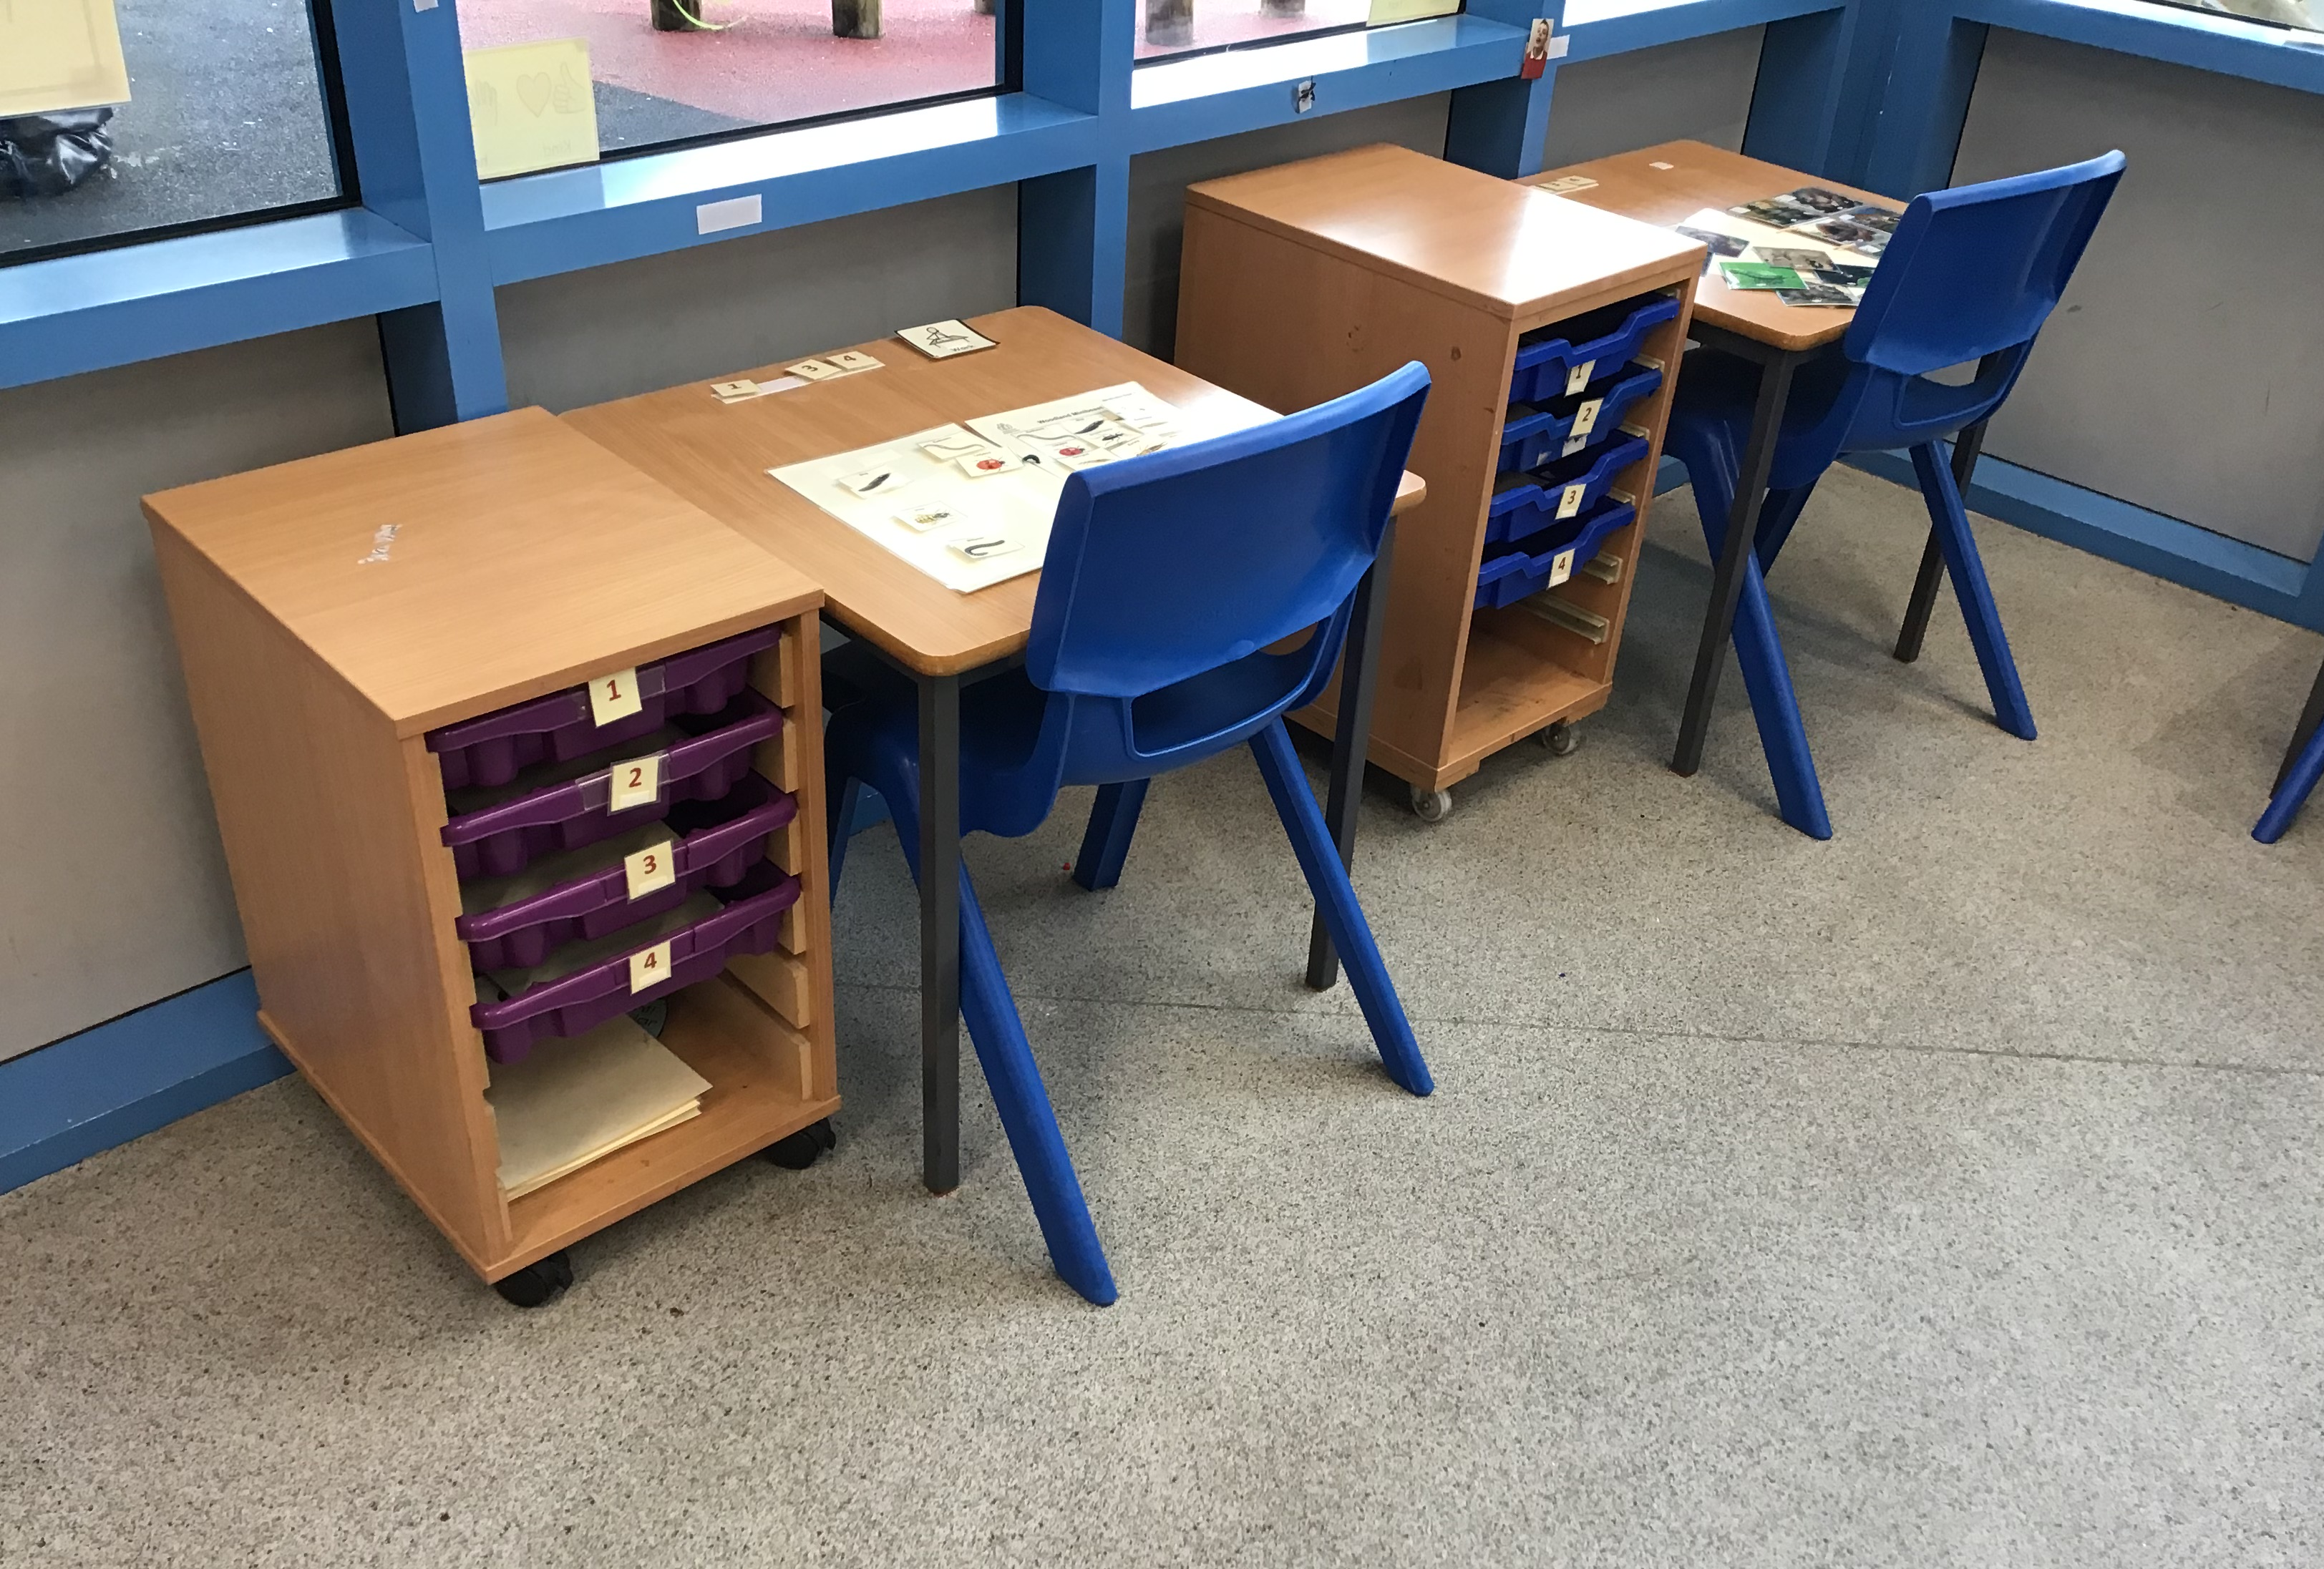
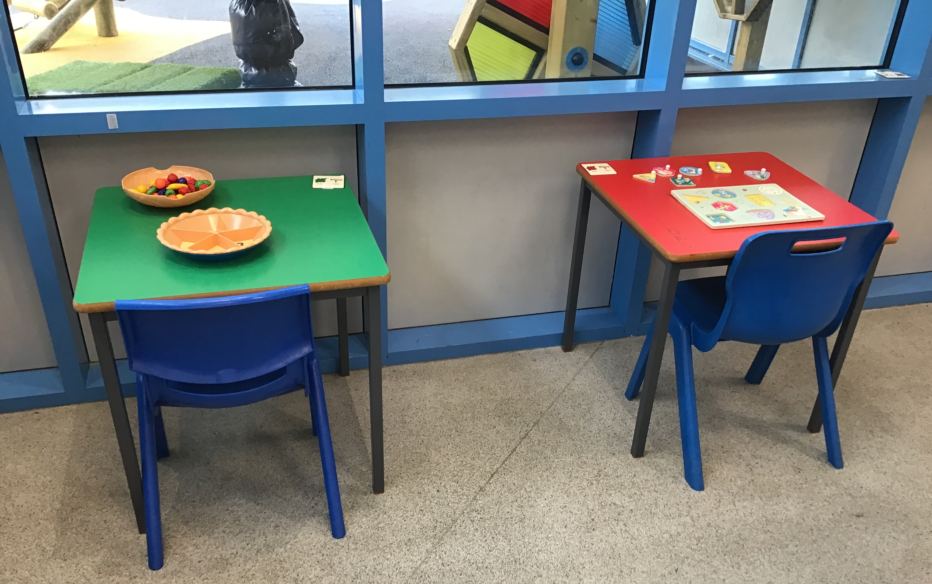
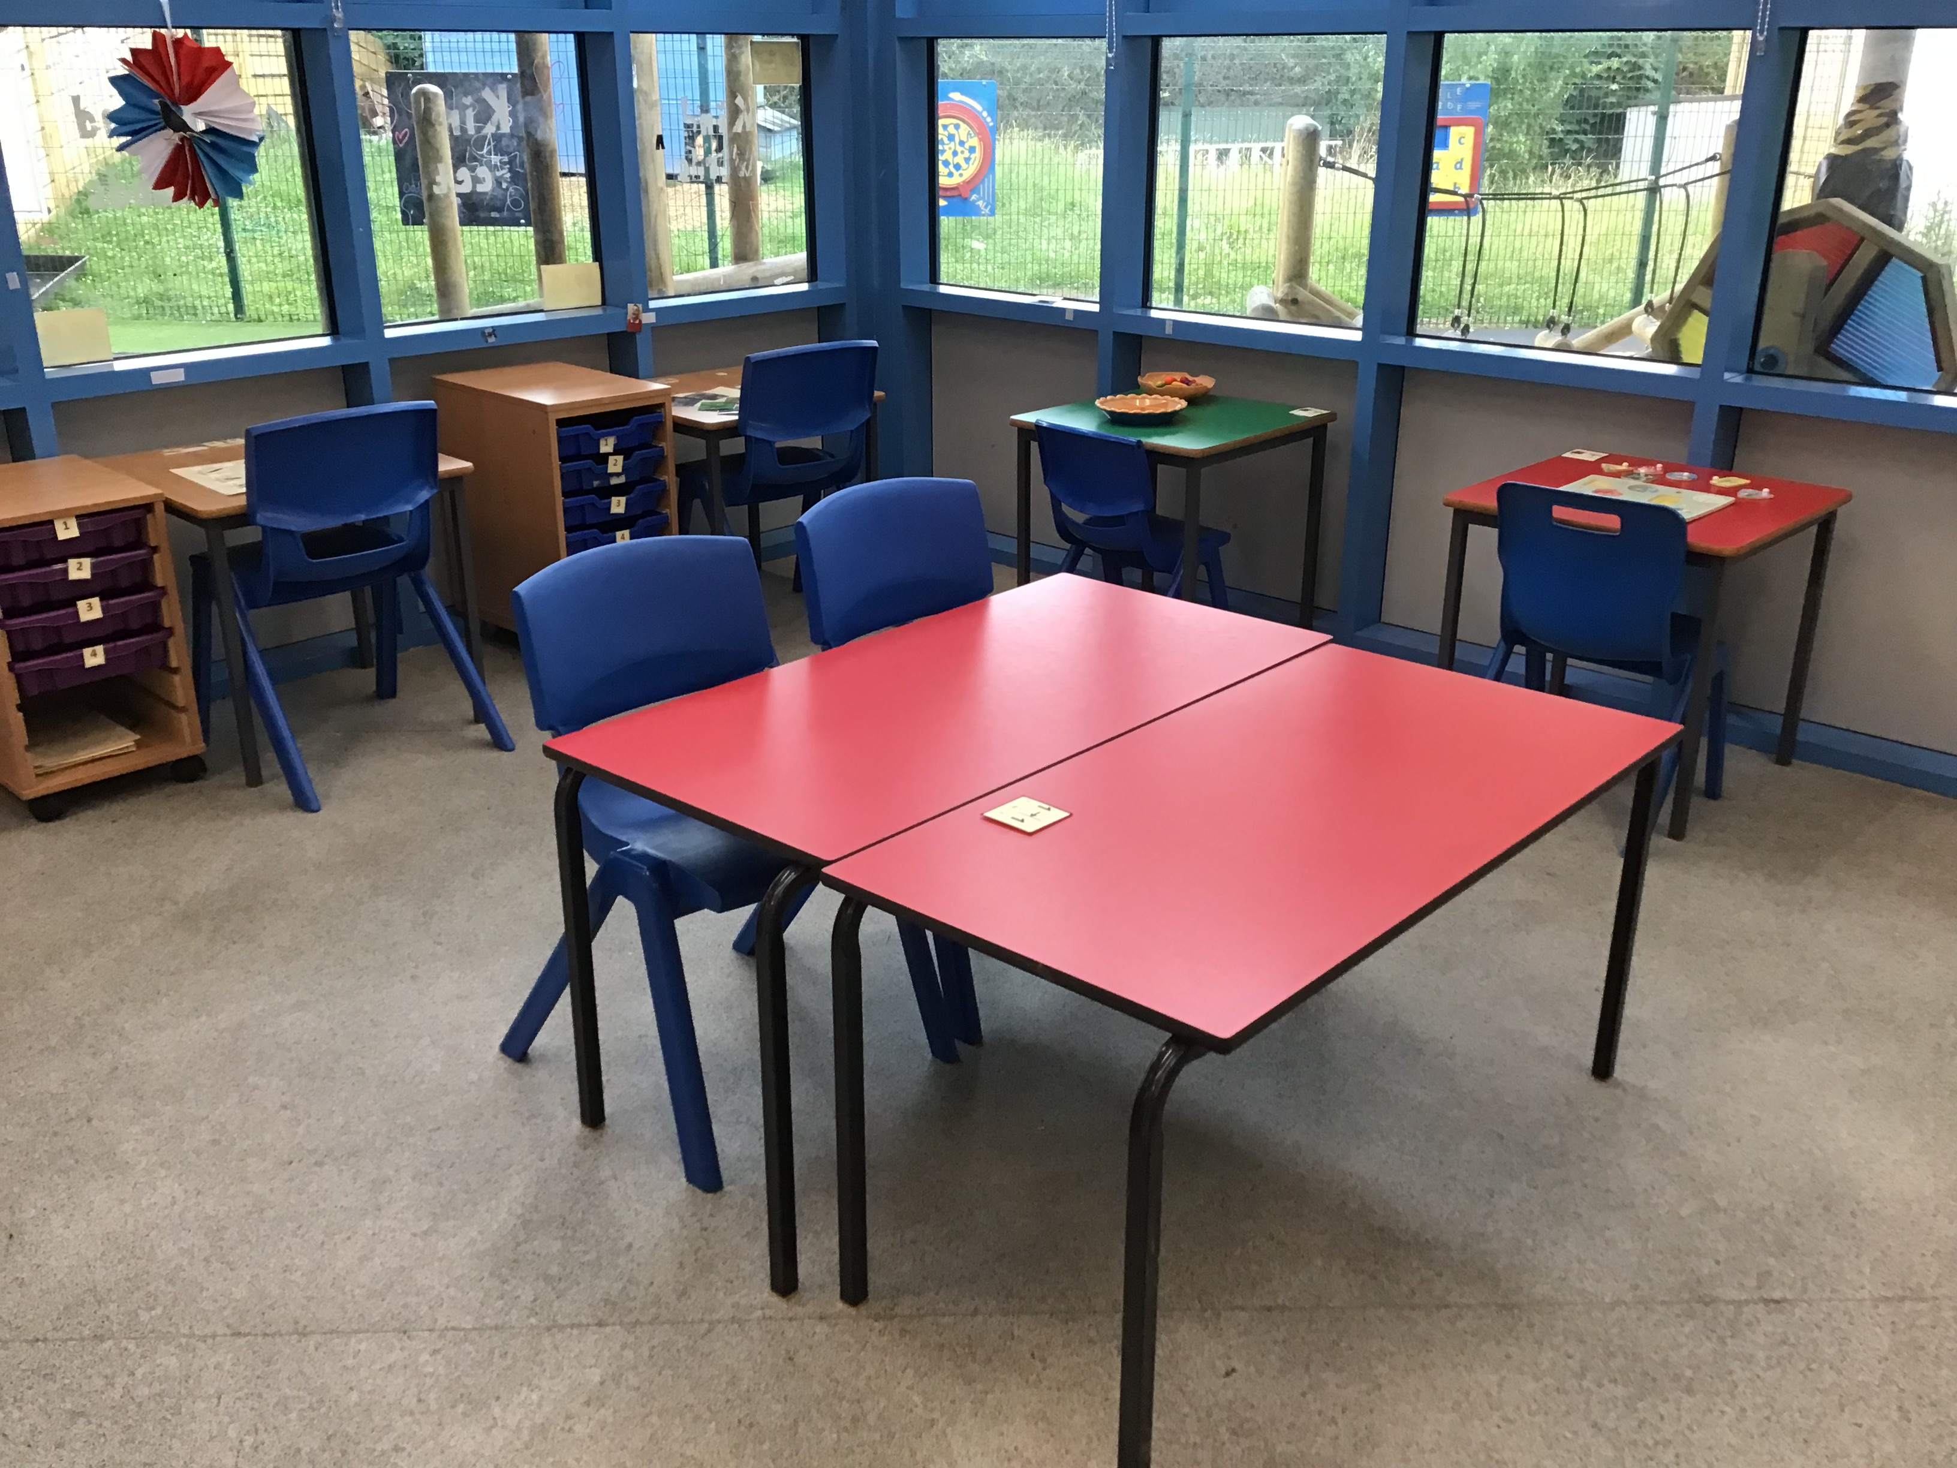
Here are some of our areas in our continuous provision.

Slide 5
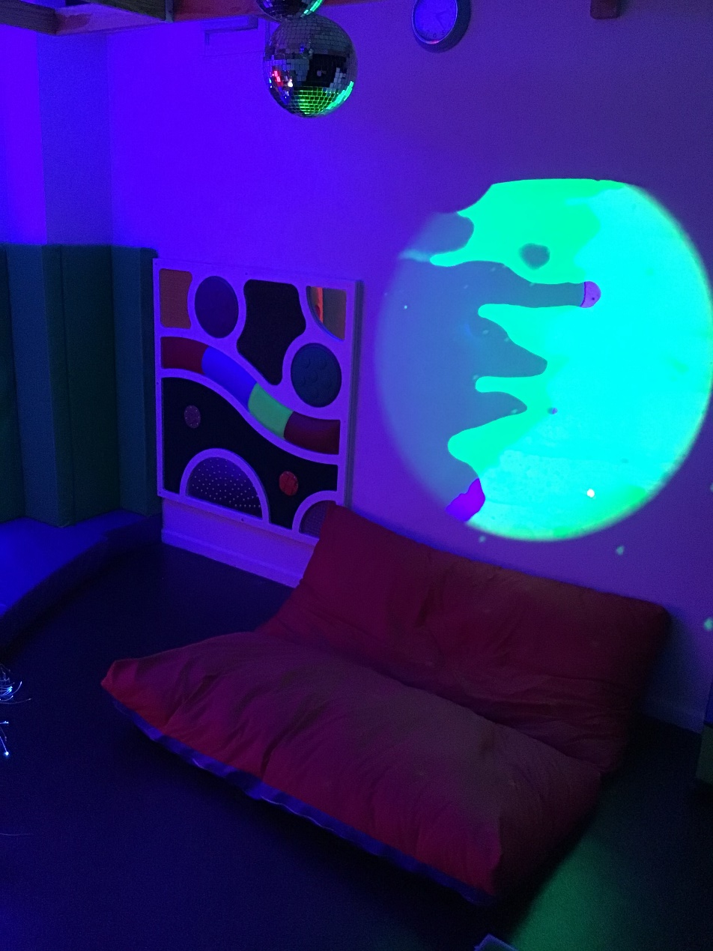
We have an amazing sensory room which we sometimes use!

Slide 6
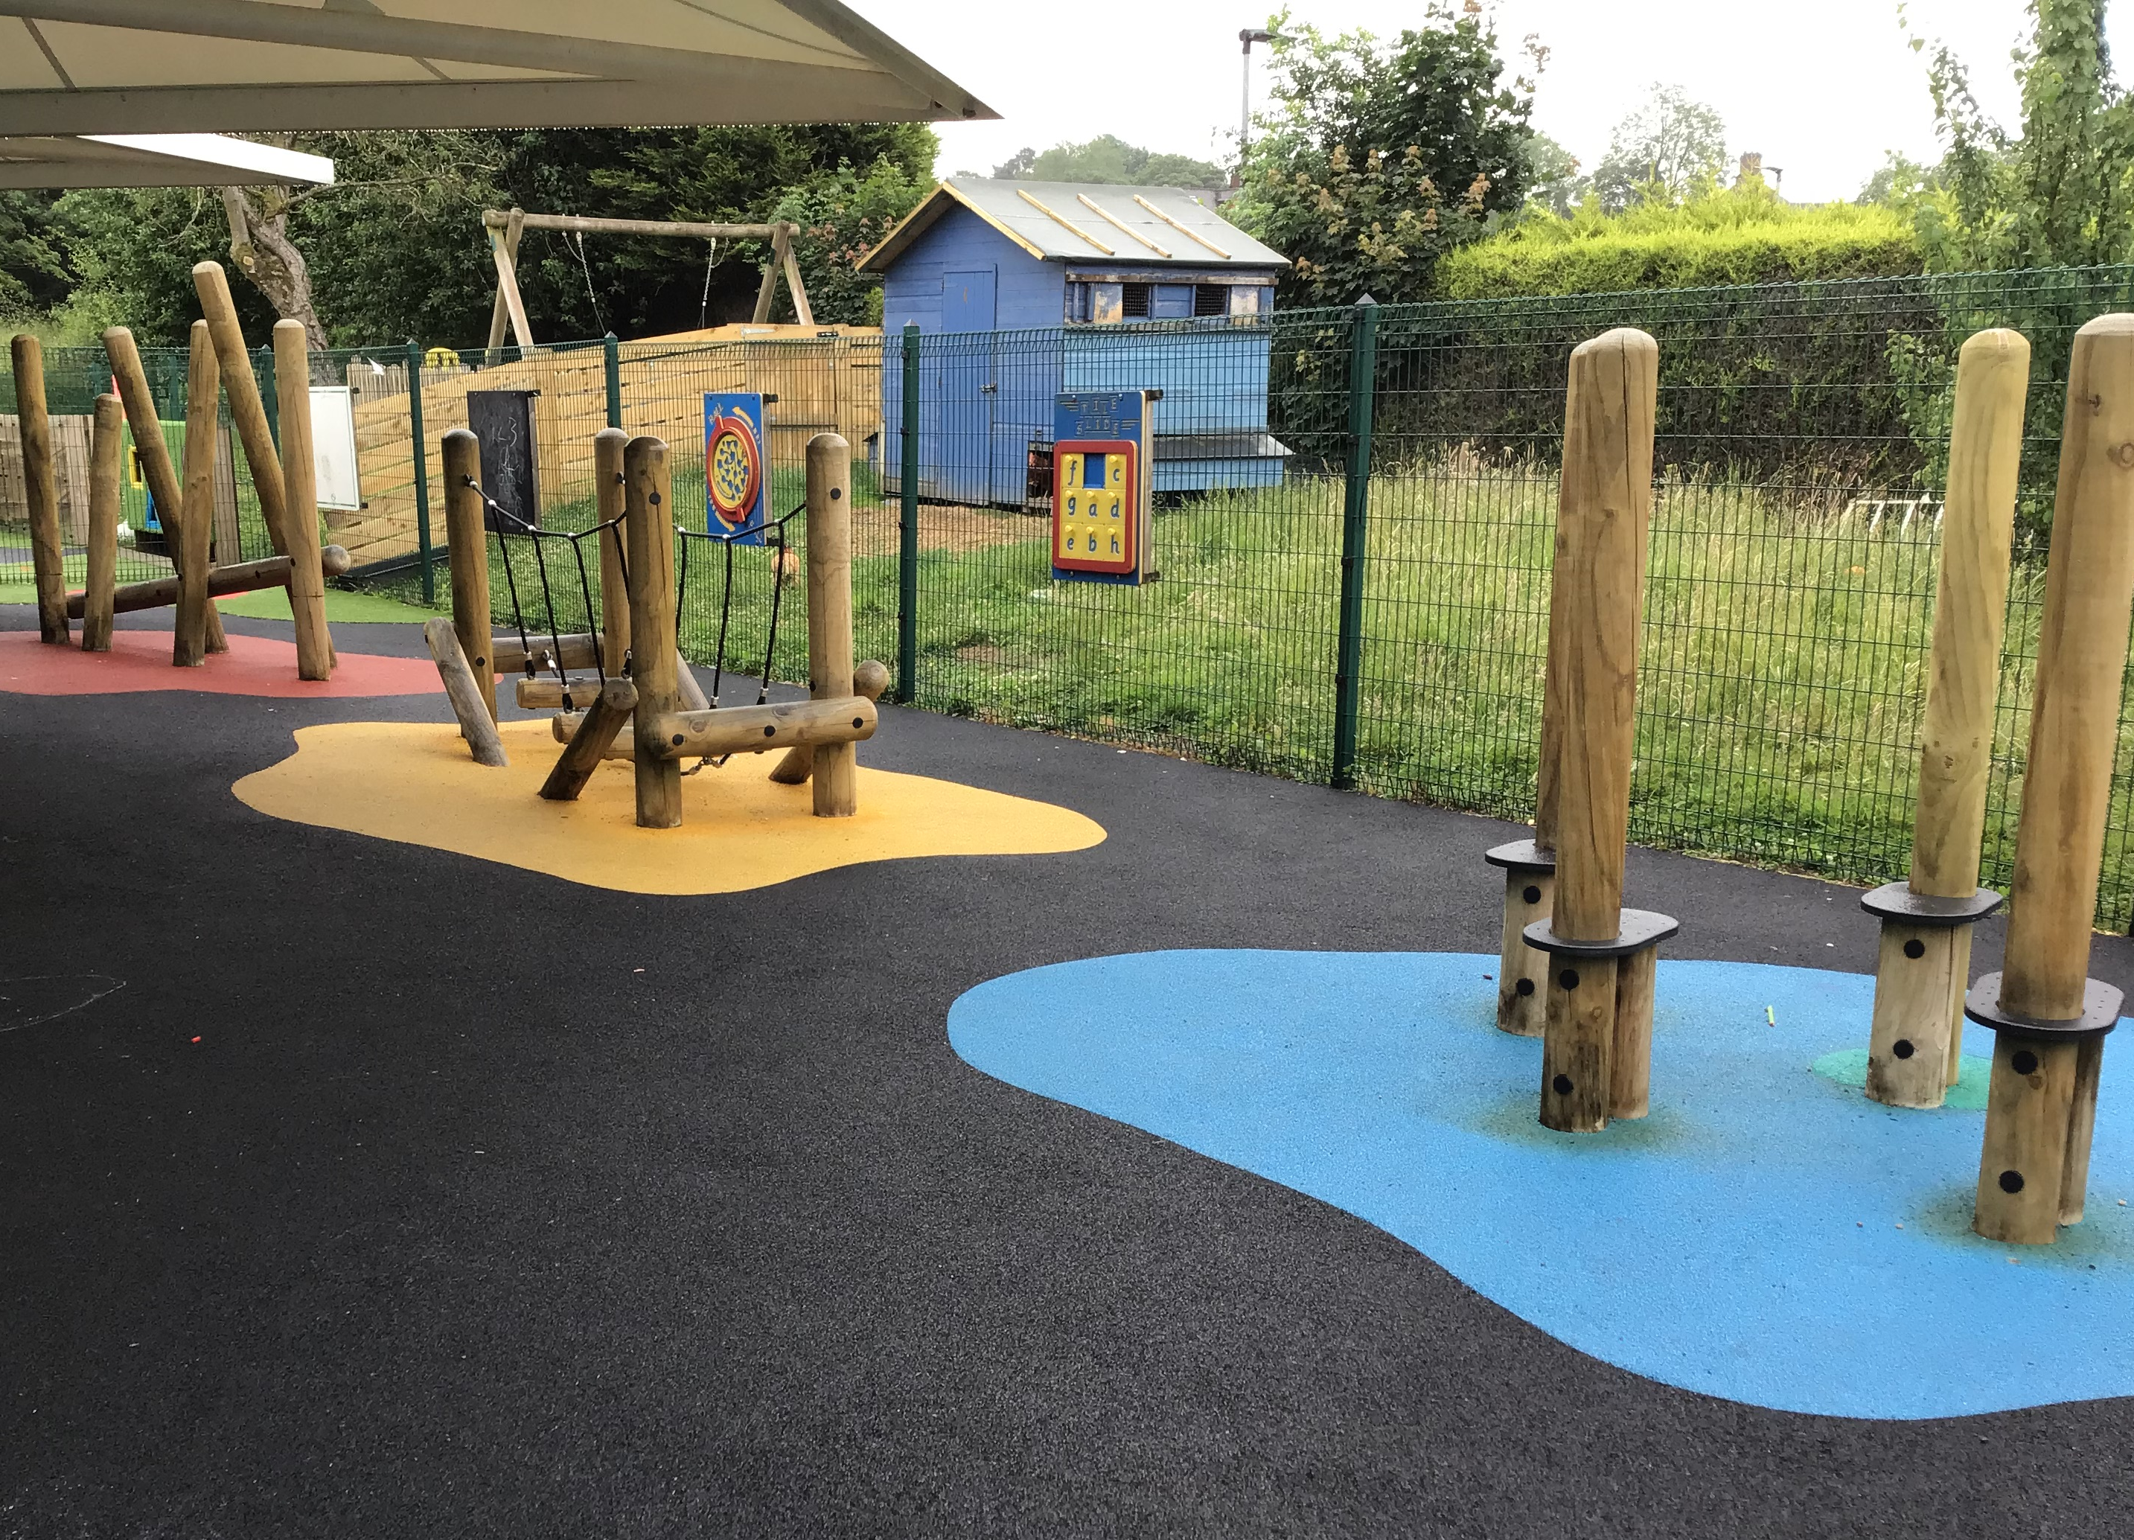
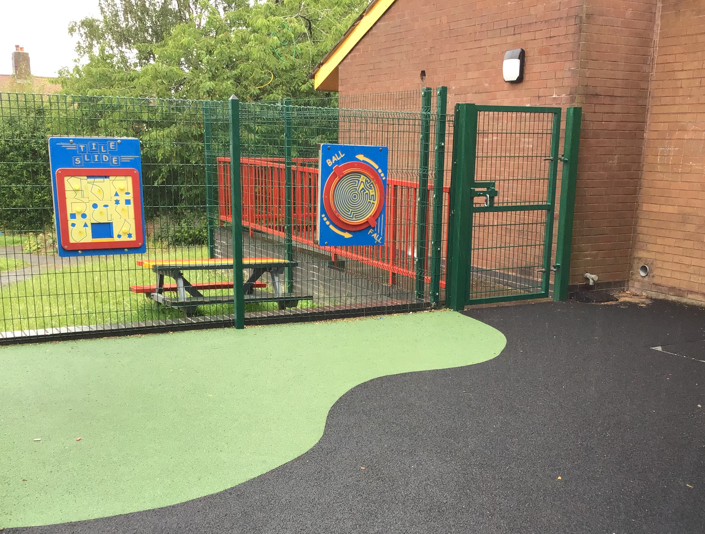
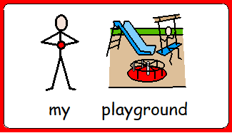
We have our own playground area which we share with Foxes Class. We also have access to the MUGA, the swing, the forest school area and the sensory garden.

Slide 7
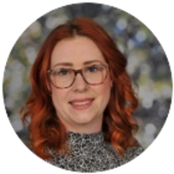
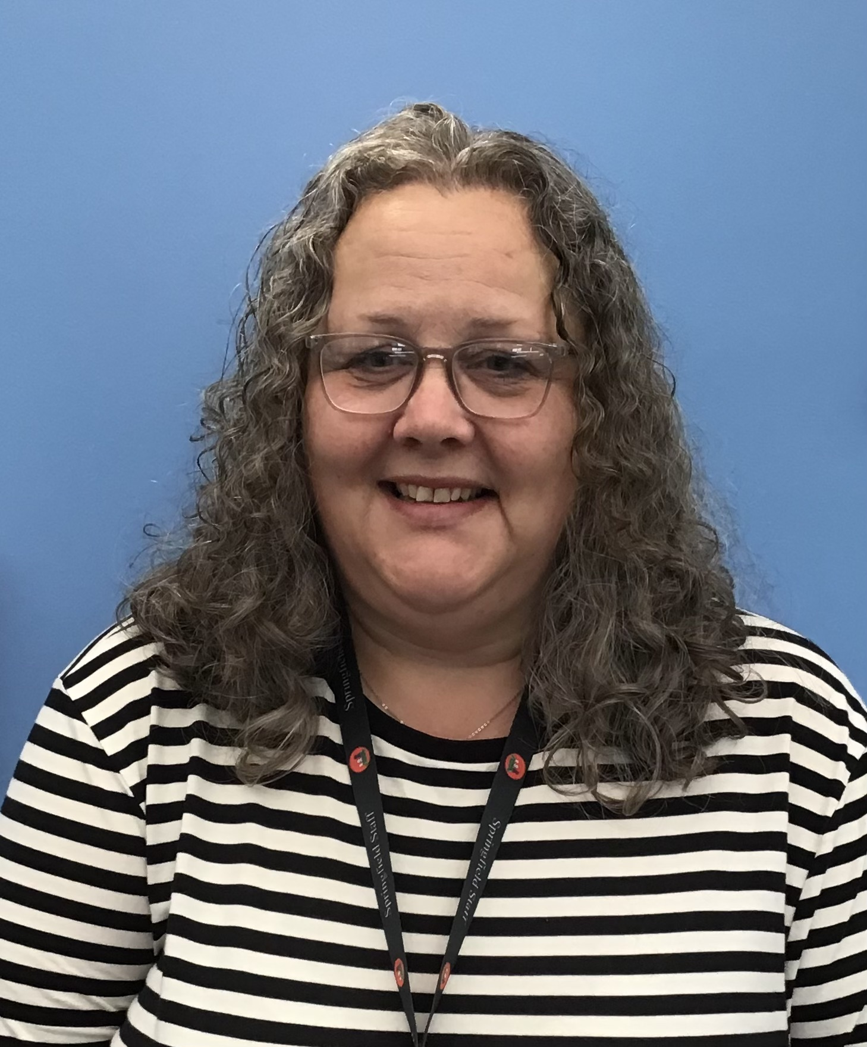
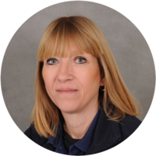
Meet the staff…
Teaching Assistant – Dani
Teaching assistant – Michele
Teaching assistant – Cathy
Dani
Cathy
Michele

Slide 8
Daily timetable…
a
9-9.30am – Phonics and registration
9.30-10.15am – Lesson time
10.15-11am – Snack time, playtime
11-11.40am – Lesson time .
11.45 – Mental Math/Reading for Pleasure
12pm – Lunchtime, playtime
1.15-2.30pm – Lesson time (there will be two separate lessons here)
2.30- 3pm – 1:1/ small group reading
3pm – End of the day and preparation for home

Slide 9
Extra information…
We have PE once a week, so please send your child with PE kit to remain in school (day to be confirmed). PE kit: jogging bottoms/ shorts (weather permitting), white t-shirt, and trainers/ pumps.
We have swimming once a week at our school pool, so please send your child to school with swimwear, and a towel (day to be confirmed).
Please send in enough snacks each day or at the start of the week. We have snack once a day and encourage children to choose using their preferred method of communication.
Please send in a water bottle to keep in school for your child to use each day. If your child drinks juice, please send in a bottle of juice and I will email you when we need more sending in.

Slide 10
Extra information…
A spare change of clothes is a good idea to keep in school, as well as sending in sun cream on hot days, and a warm-waterproof coat during the winter.
We make the most of being outside in all weather and we also have Forest School sessions too, so please send in wellies that we can keep in school for your child.
Reading books will be sent home each day and changed weekly. It is really important that children read daily at home.
Blackbirds have a class page that you will find on the website. All planning and information is located on this page.
Homework will be set on a termly basis, this is also located on the class page.
The school day starts at 8.55am and finishes at 3.15pm. If your child is accessing transport, please be assured that a member of staff will collect them and walk them safely into school.
If you have any questions at all, please email us at blackbirds@springfield.staffs.sch.uk (Helen and Louise) or contact the office - 01538 383558.
Thank you! We are looking forward to our new Blackbirds class in September! ☺

