Slide 1
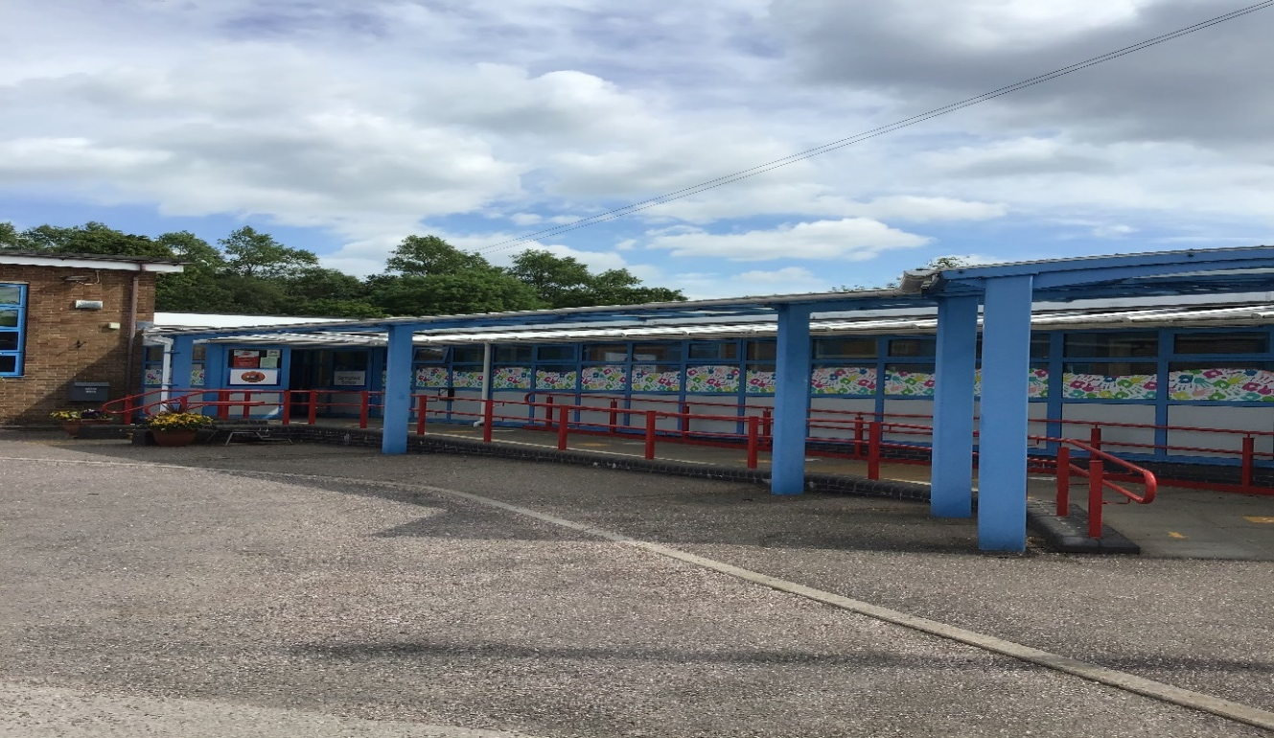
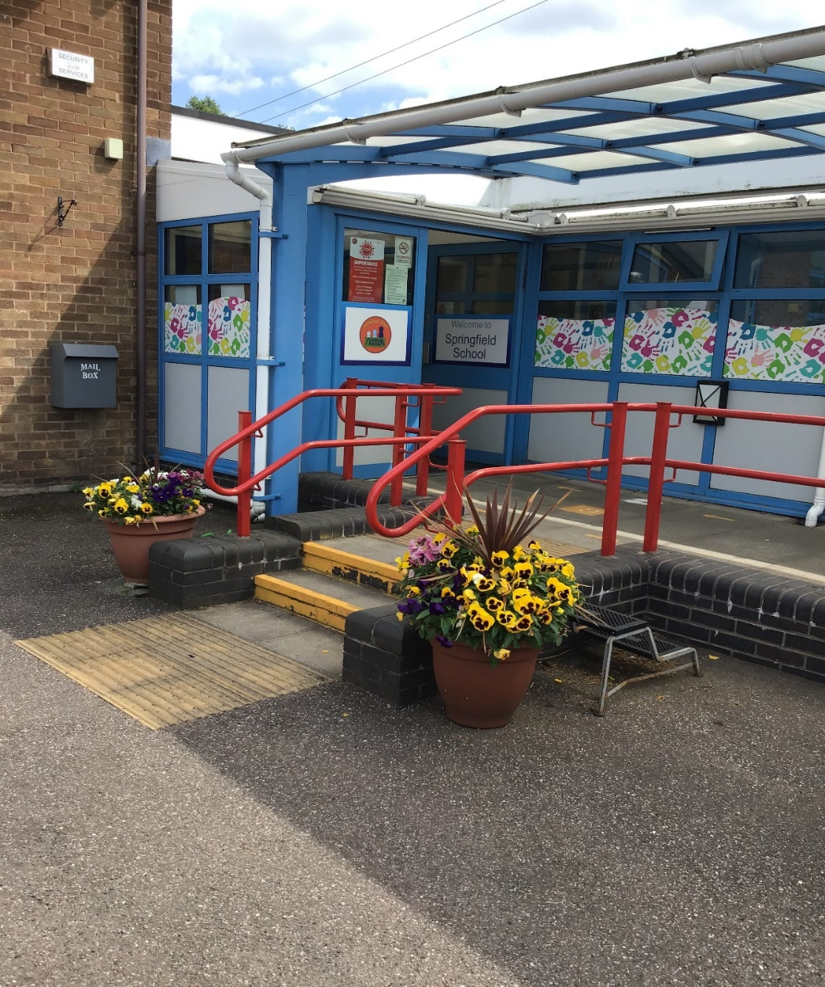
Welcome back to Springfield School! I am Claire – Badger’s class teacher.

Slide 2
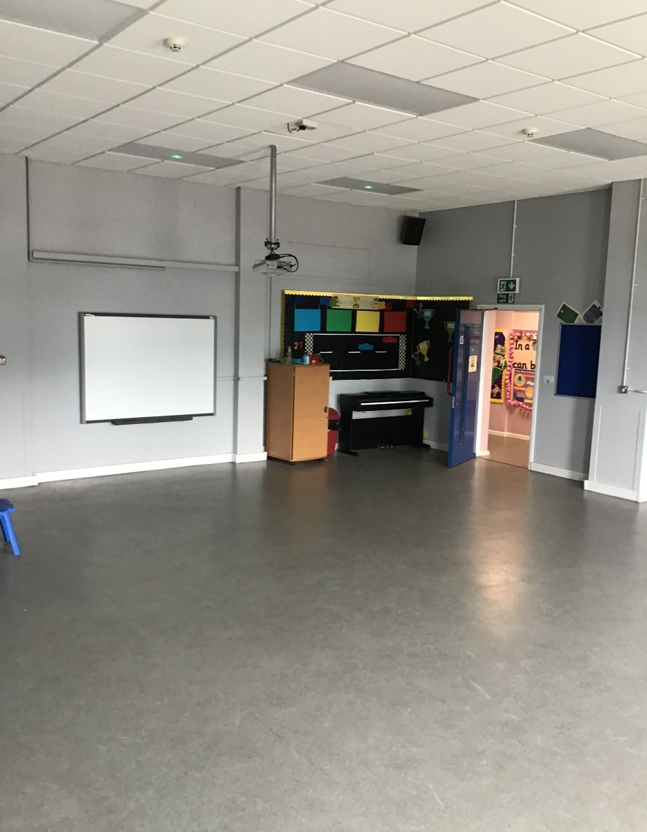
Here is our main reception and the hall. We have our PE sessions in the hall one day per week .

Slide 3
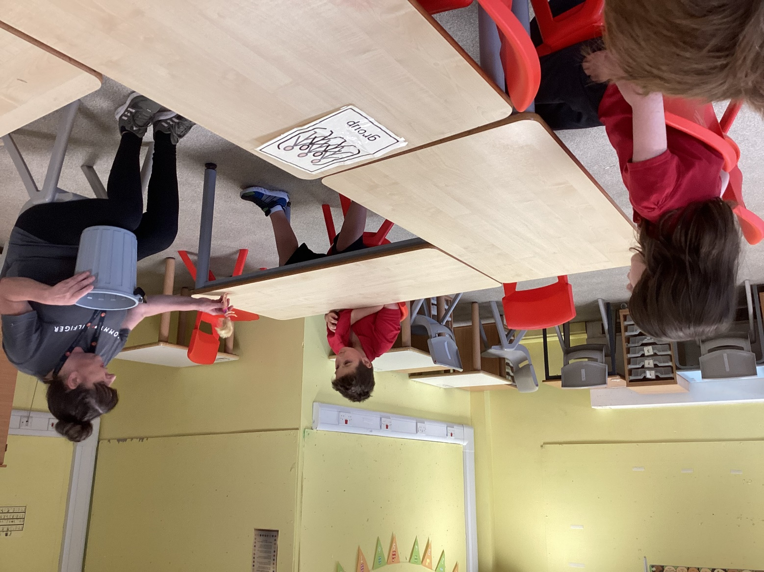
This is Badgers classroom. We have our group table, learning areas and work stations.

Slide 4
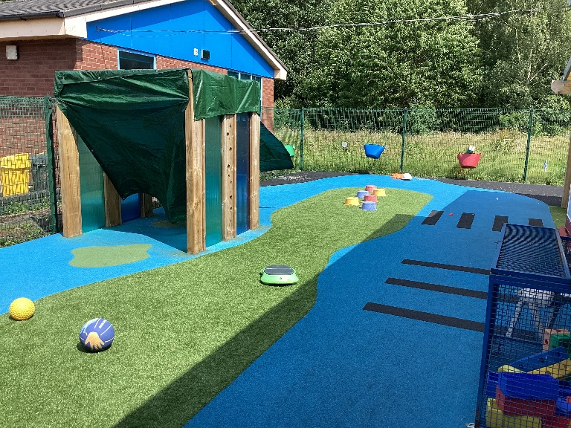
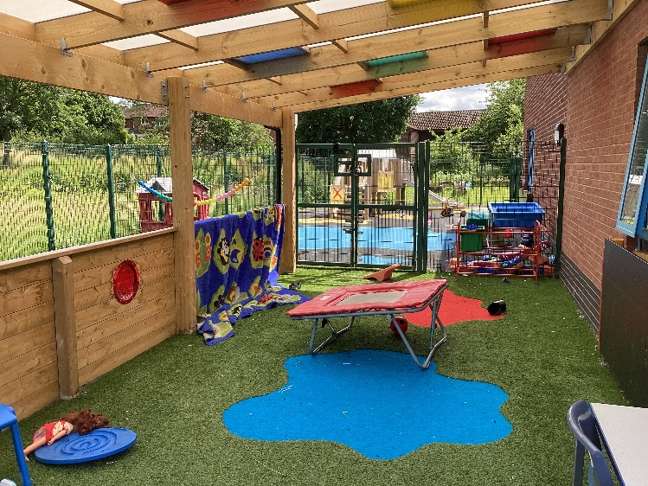
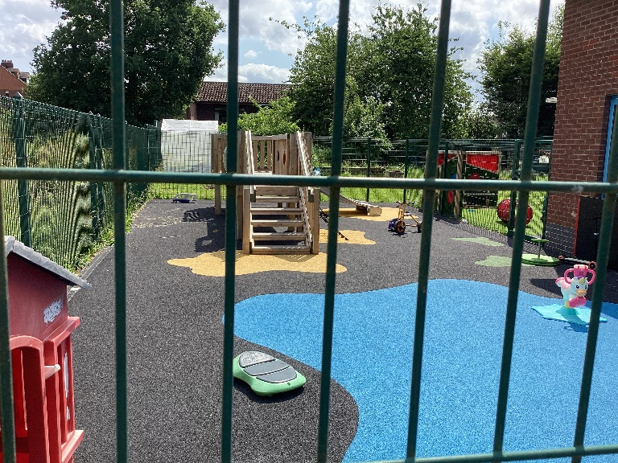
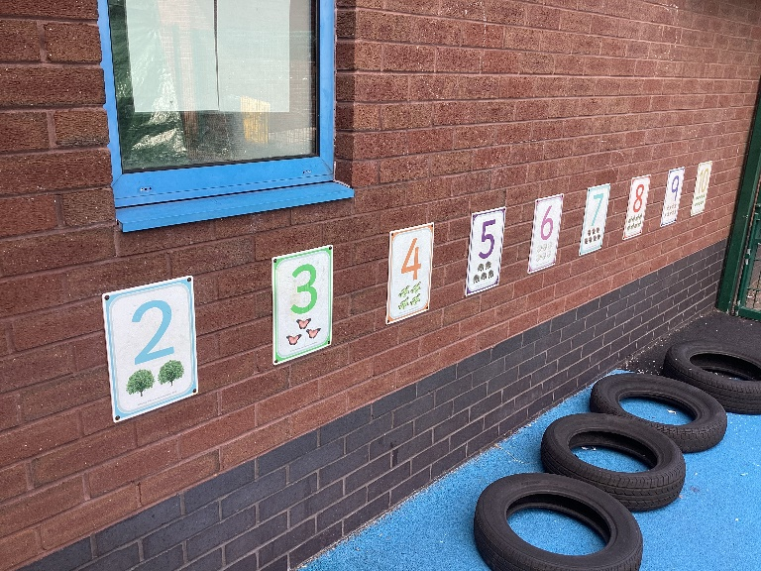
We also have a waterproof den, a big playground with bikes, scooters and sensory diet toys as well as access to the bridge area.

Slide 5
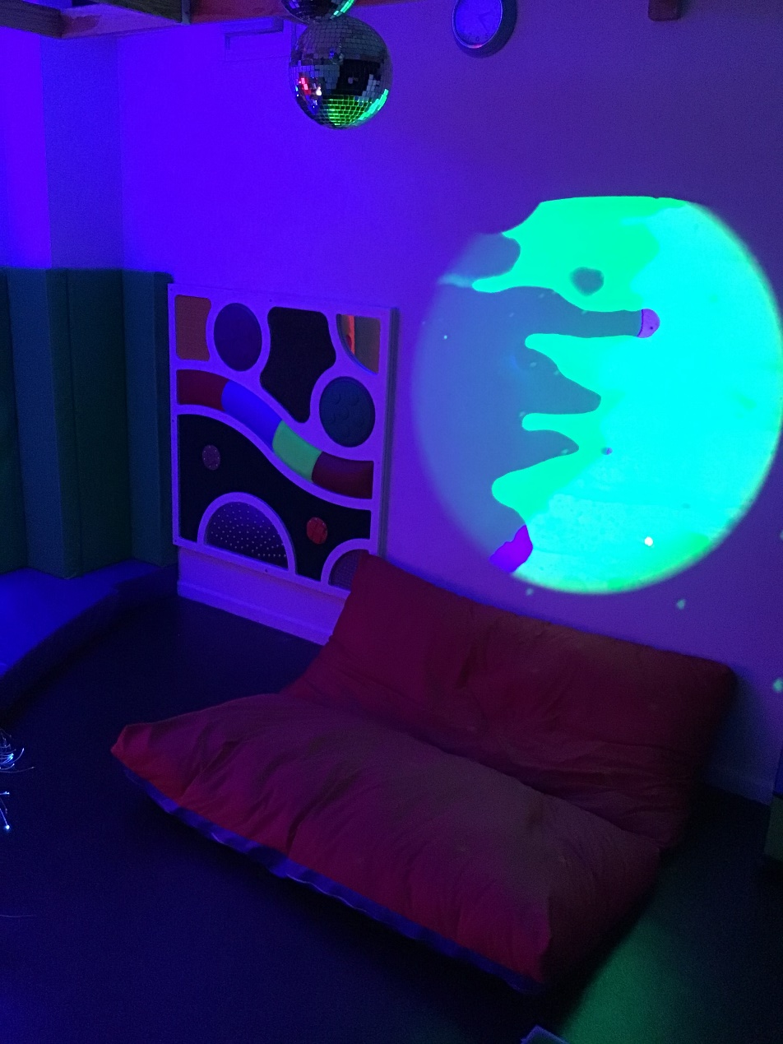
We have an amazing sensory room which we use regularly.

Slide 6
Meet the staff…
In Badgers class, we have one class teacher and 4 teaching assistants with our eight children:
Class teacher – Claire
Teaching Assistant – Tash, Teaching assistant – Sonya
Teaching Assistant – Ceara, Teaching assistant – Helena – 3 days
Tash
Sonya
Ceara
Helena

Slide 7
Daily timetable…
9-9.30am – Sensory diet, signing in and greeting (name finding / writing), phonics
9.30-10.15am – English
10.15-11am – Snack time, play time and toileting
11-11.50am – Focussed lesson (group time and 1:1 activities) with access to structured and unstructured activities within the room.
11.50-12pm – Group time. 12-1.15 pm – Lunch time and play time, toileting.
1.30-2.15pm – Focussed lesson with access to structured and unstructured activities within the room.
2.15pm – Snack time, playtime, toileting.
2.30-3pm – Focussed lesson with access to structured and unstructured activities within the room.
3pm – End of the day
*Focused lessons will be English, Maths, Phonics, Key Skills/ Interventions, PSHE, RE, Science, PE and Swimming, Art and Design, Design and Technology, Computing, Geography, History, and Music.

Slide 8
Extra information…
We have PE once a week, so please send your child to school wearing their PE kit on Mondays. PE kit: jogging bottoms/ shorts (weather permitting), white t-shirt, and trainers/ pumps.
We have swimming once a week at our school pool, so please send your child to school with swimwear, a swim nappy/swim pants and a towel – all labelled, on Wednesdays.
If required please send in enough nappies/ wipes for the week – I will email you when your child is running low on these.
We provide drinks and snacks in school for £2 a week – please send in a labelled envelope if you wish your child to have this.
If your child is entitled to free school meals and you would like us to order a meal or a taster plate for your child, then please let us know.

Slide 9
Extra information…
At least one spare change of clothes is essential to keep in school including spare footwear, socks, pants, as well as applying and sending in sun cream on sunny days between April and September, also a warm-waterproof coat during colder weather.
We make the most of being outside in all weather and we also have Forest School sessions too, so please send in some waterproofs and wellies that we can keep in school for your child.
Reading books will be sent home each day and changed weekly. It is really important to share books with your child, encouraging them to feel the pages/ lift the flaps/ pull the tabs and read etc.
The school day starts at 8.55am and finishes at 3.15pm. If your child is accessing transport, please be assured that a member of staff will collect them and walk them safely into school.
If you have any questions at all, please email me at badgers@springfield.staffs.sch.uk (Claire) or contact the office - 01538 383558.
Thank you! We are looking forward to our new Badgers class in September! ☺

