Slide 1
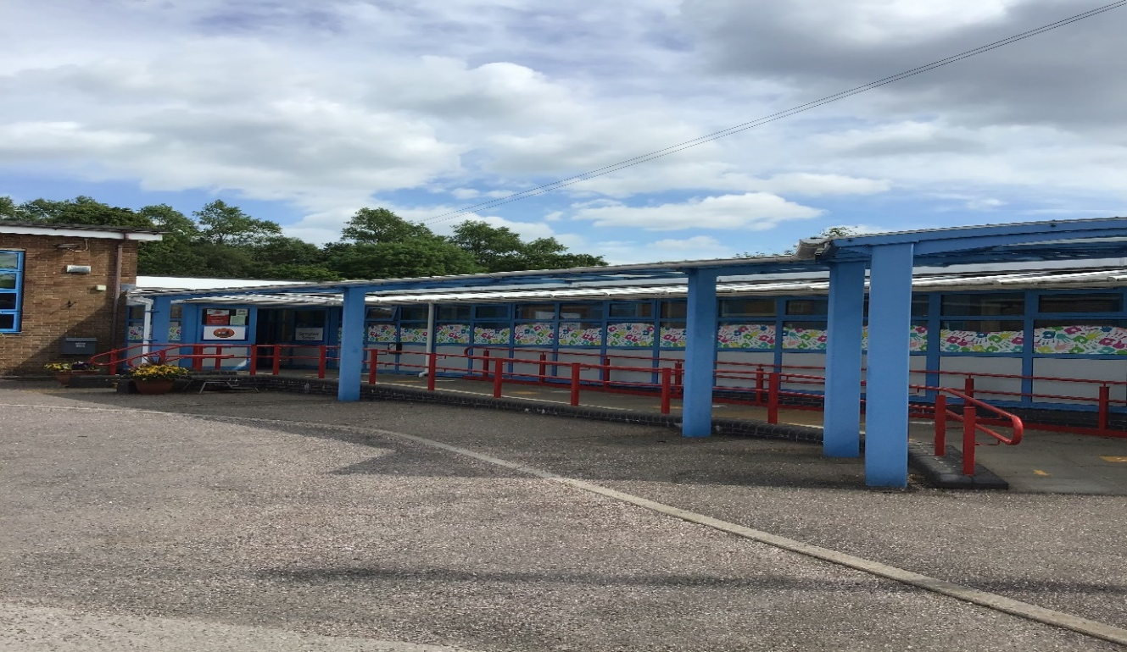
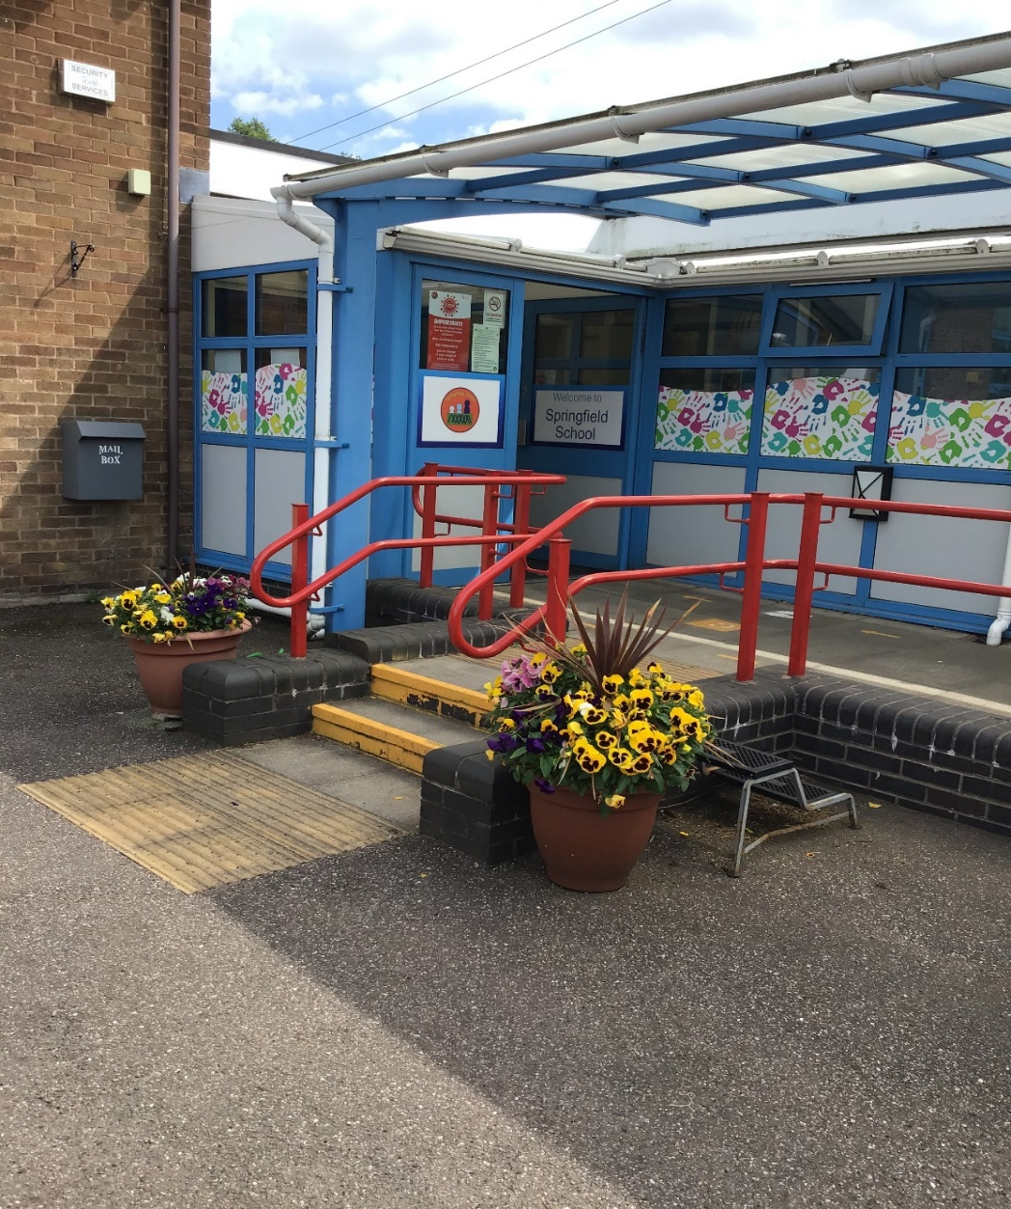
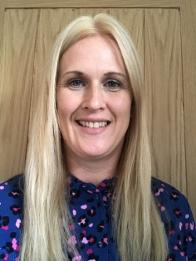
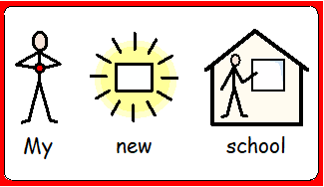
Welcome to Springfield School! I am Anna – one of the Co-Head Teachers. We are busy appointing a new teacher for Rabbits class.

Slide 2
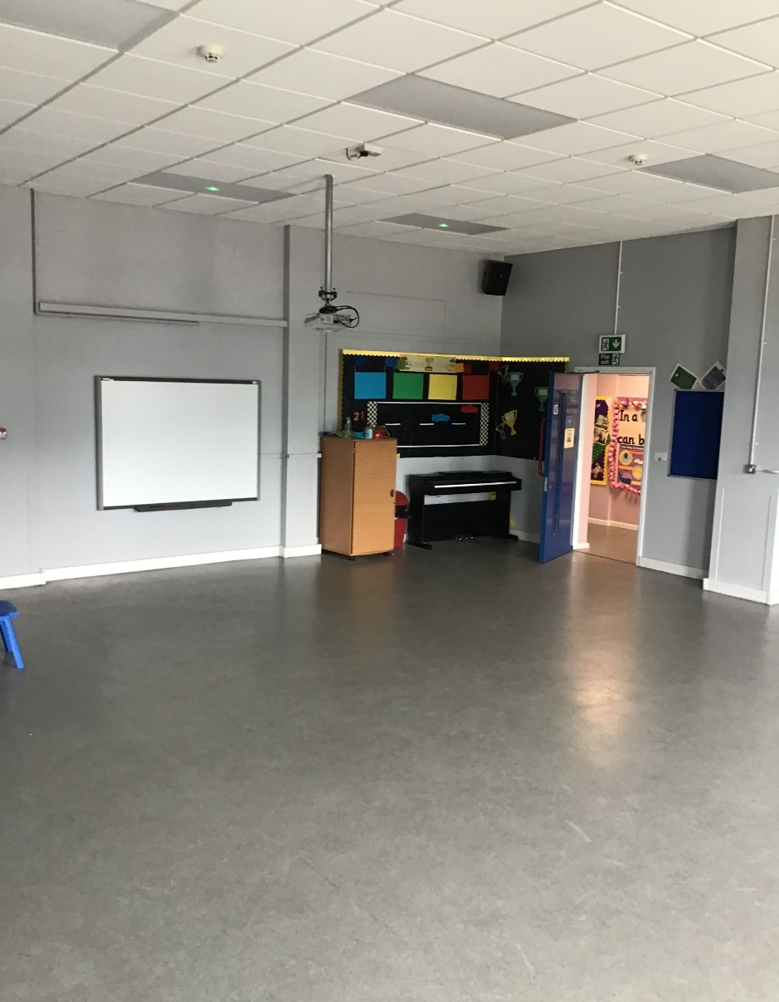
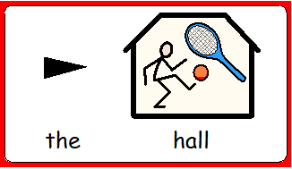
Here is our main reception and the hall. We have our PE sessions in the hall.

Slide 3
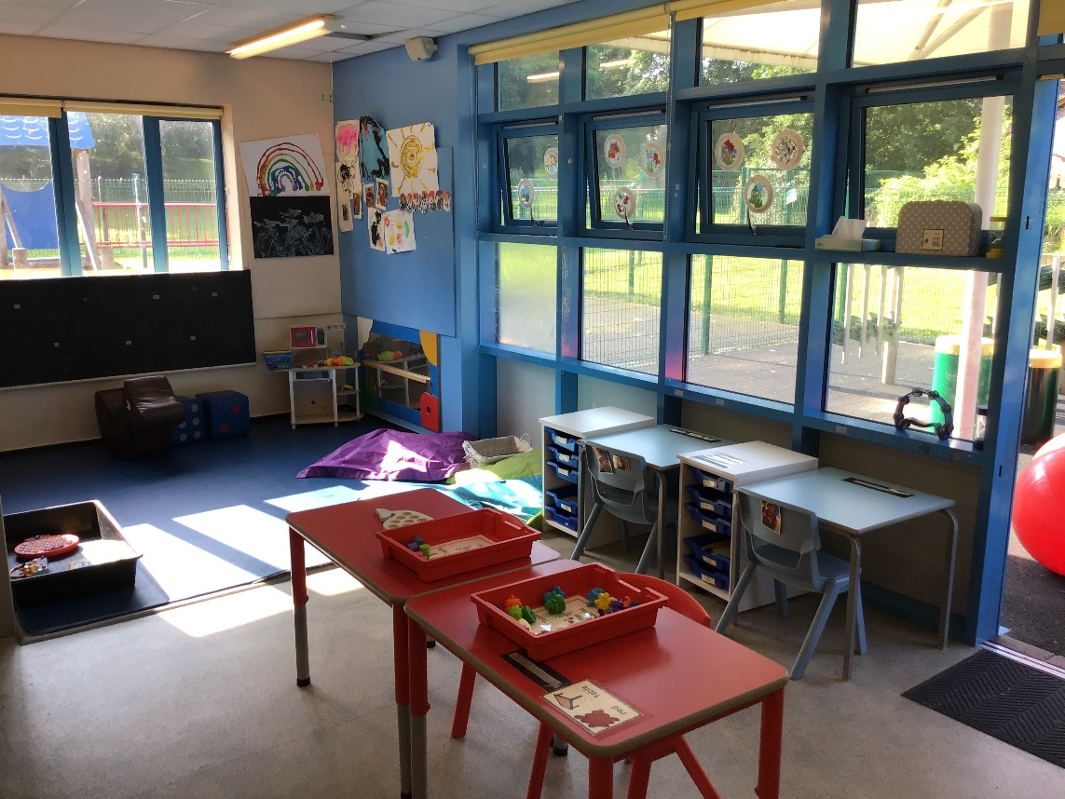
This is Rabbits classroom.

Slide 4
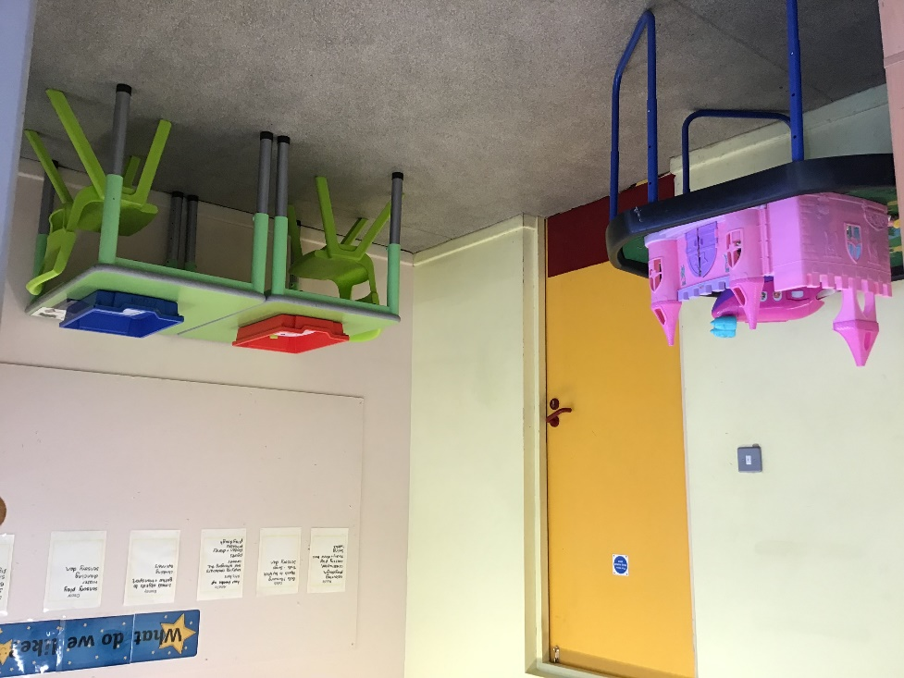
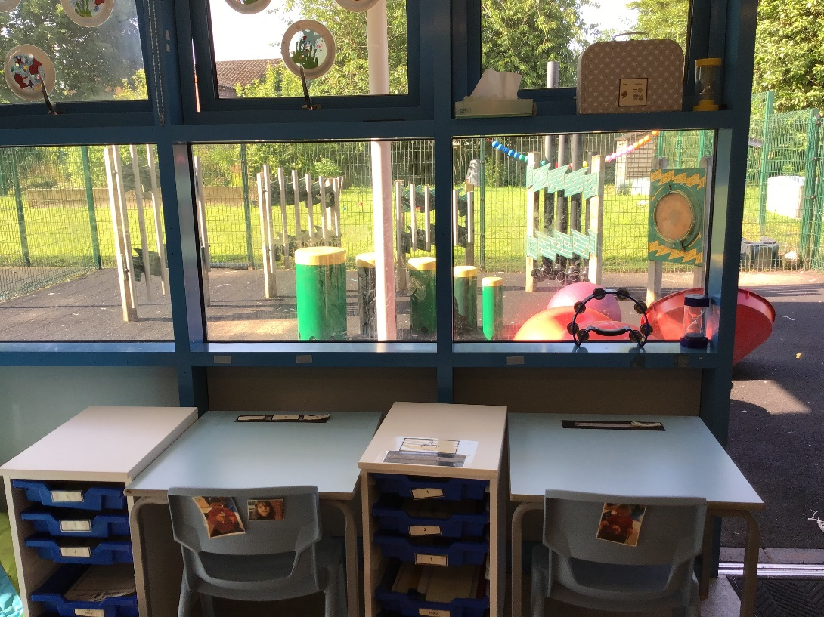
Here is our group table for our group sessions at the front of the classroom. We have a den, access to favourite toys, sensory diet area, quiet reading area and messy play.

Slide 5
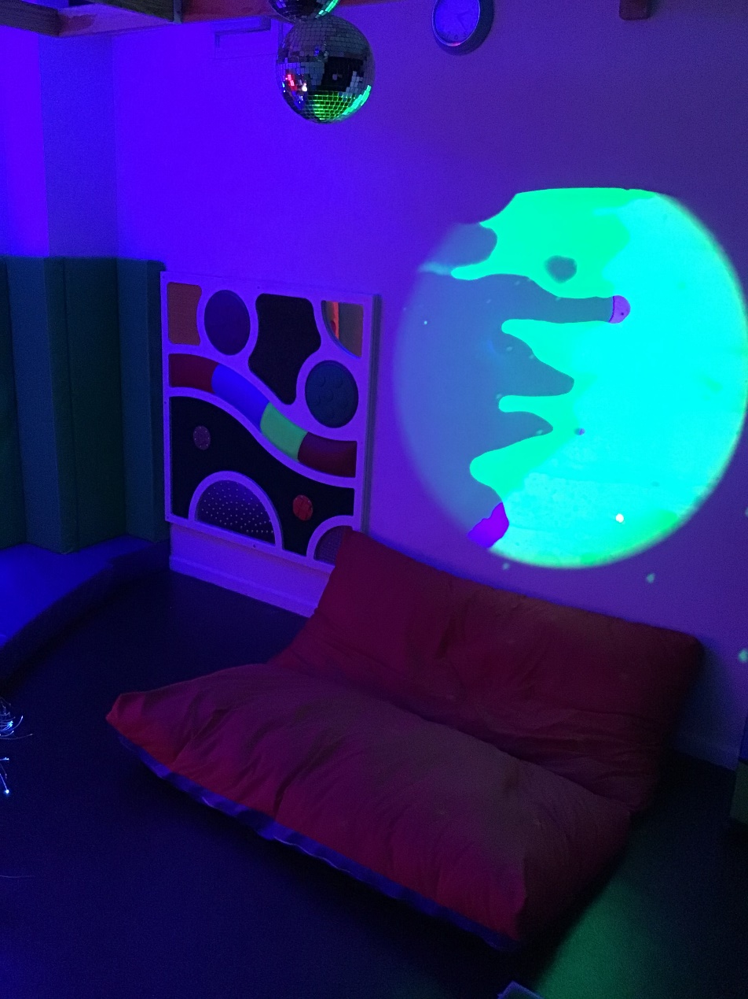
We have an amazing sensory room which we use twice a week!

Slide 6
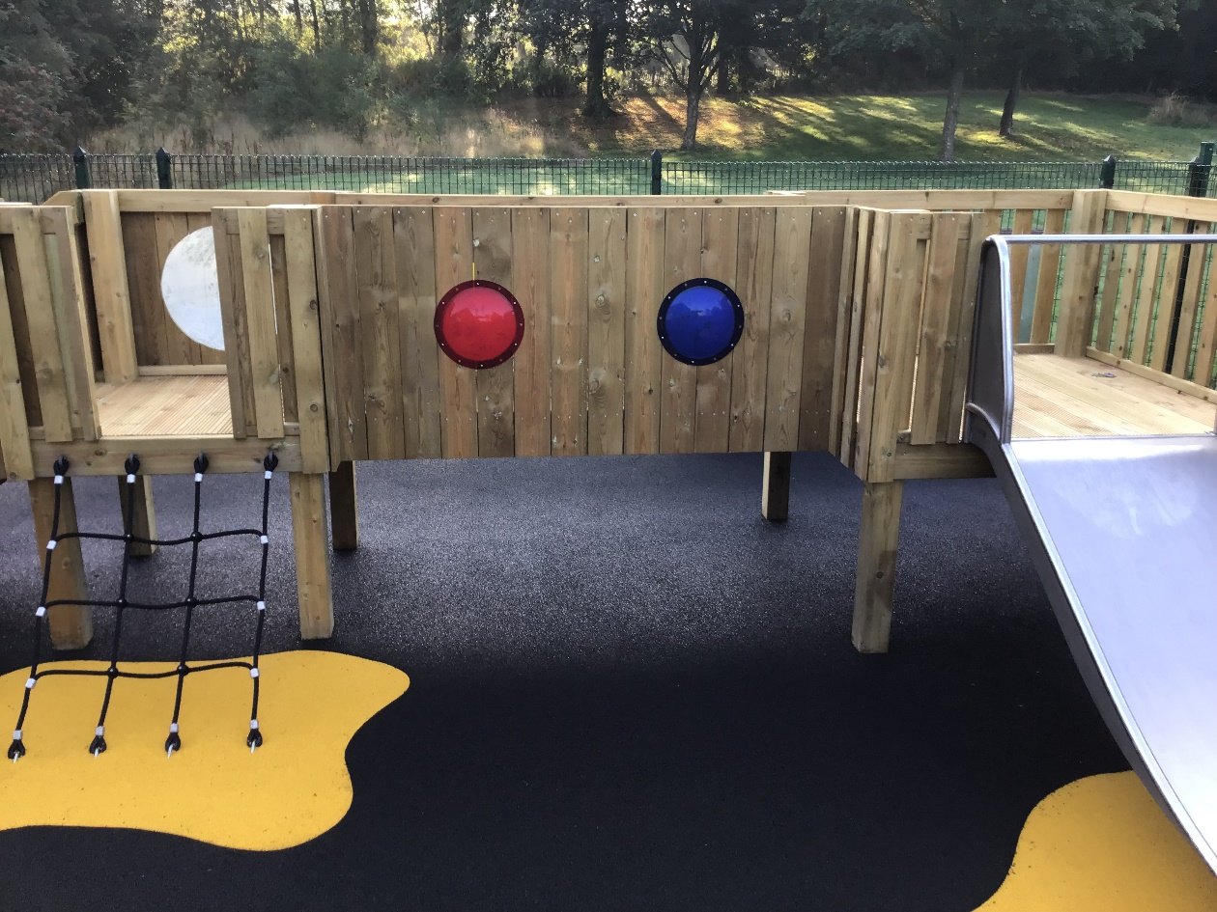
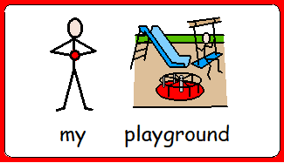
These are our new playground areas.

Slide 7
Meet the staff…
In Rabbits class, we have one class teacher, 1 HLTA and 2 teaching assistants:
Class teacher – We are appointing a new teacher.
Senior Teaching Assistant – Sue
Teaching assistant – Molly
Teaching assistant – Jayne

Slide 8
Example Daily timetable…
9-9.30am – Daily mile outside, Signing in (name finding / writing), Reading
9.30-10.10am – Greeting; Days of the Week; Focussed lesson with access to Structured and unstructured activities within the room, inside and outside.
10.15-11am – Snack time, play time and toileting
11-11.50am – Focussed lesson with access to Structured and unstructured activities within the room, inside and outside.
11.50-12pm - Group before lunch, 12-1.15pm – Lunch time and play time, toileting
1.15-2.15pm – Focussed lesson with access to Structured and unstructured activities within the room, inside and outside.
2.15pm – Snack time, playtime, toileting
2.40-3pm – Music or Story time
*Focussed lessons will be English, Maths, Key Skills, PSHE, Science, PE, including Forest Schools and Swimming, RE, Art and Design, Design and Technology, Computing, Geography and History

Slide 9
Extra information…
Our PE day is yet to be decided, however please send your child to school wearing their PE kit when you know the day!
Please send in enough snacks and nappies/ wipes for the week – We will email you when your child is running low on these.
Reading books will be sent home each day and changed weekly. It is really important to share books with your child, encouraging them to feel the pages/ lift the flaps/ pull the tabs etc.
Water bottles to be sent in each day or we can keep one in school for your child.
A spare change of clothes is a good idea to keep in school, as well as sending in sun cream on hot days, and a warm-waterproof coat during the winter (wellies too).
If you have any questions at all, please email us at rabbits@springfield.staffs.sch.uk

Slide 10
Further information will be emailed to you with staff photos and your new class teacher will contact you too.
Please use the class email to ask us any questions you have.
We will also be introducing Class dojo to communicate with you too.

