Slide 1
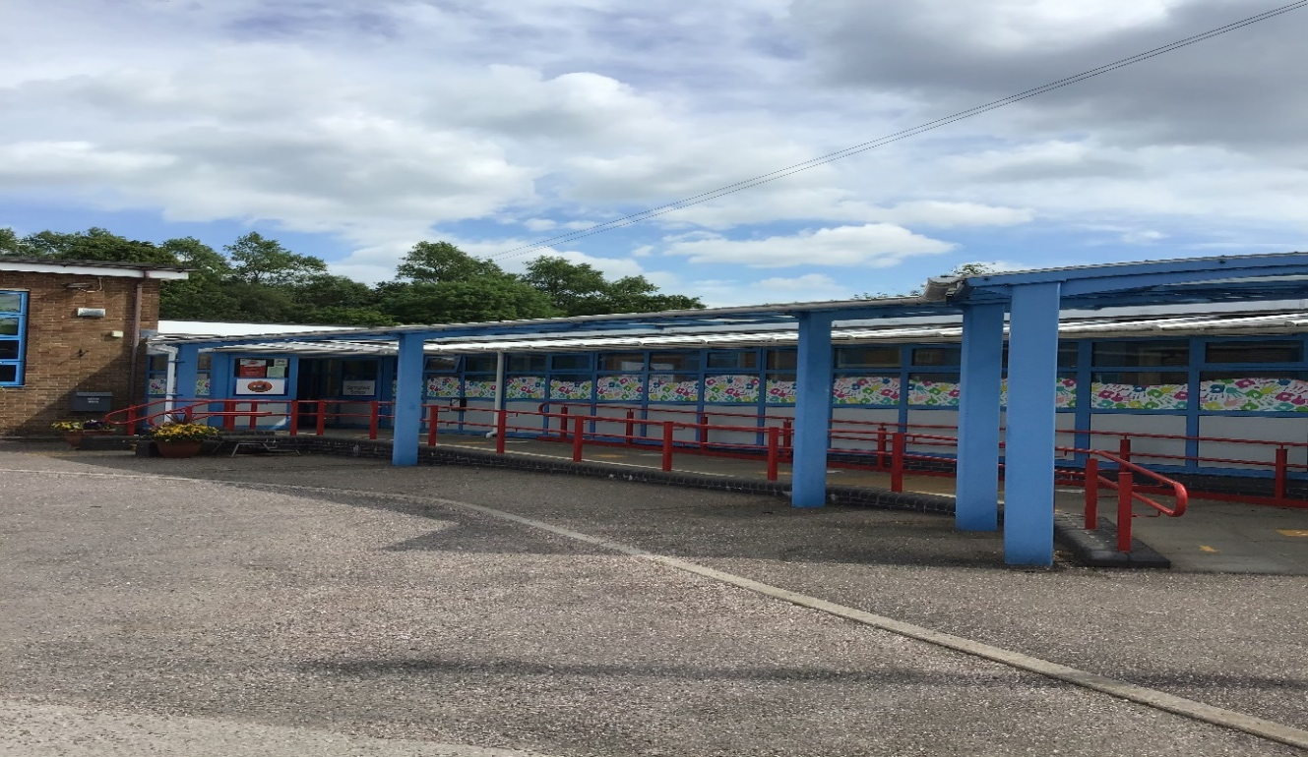
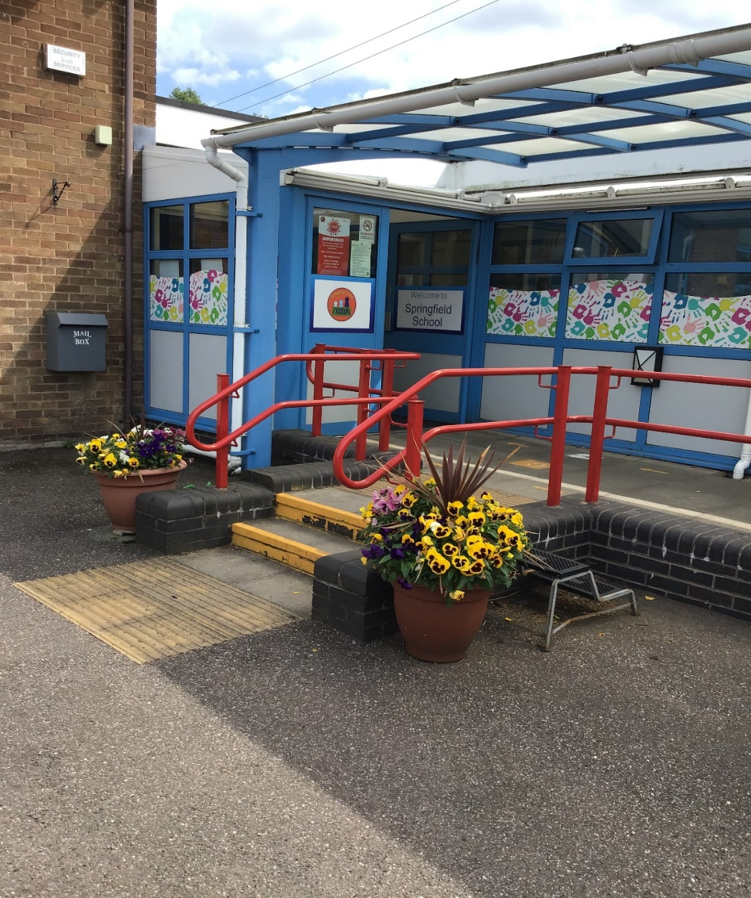
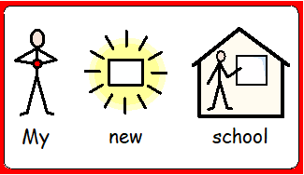
Welcome to Springfield School! I am Demi – Hedgehogs class teacher.

Slide 2
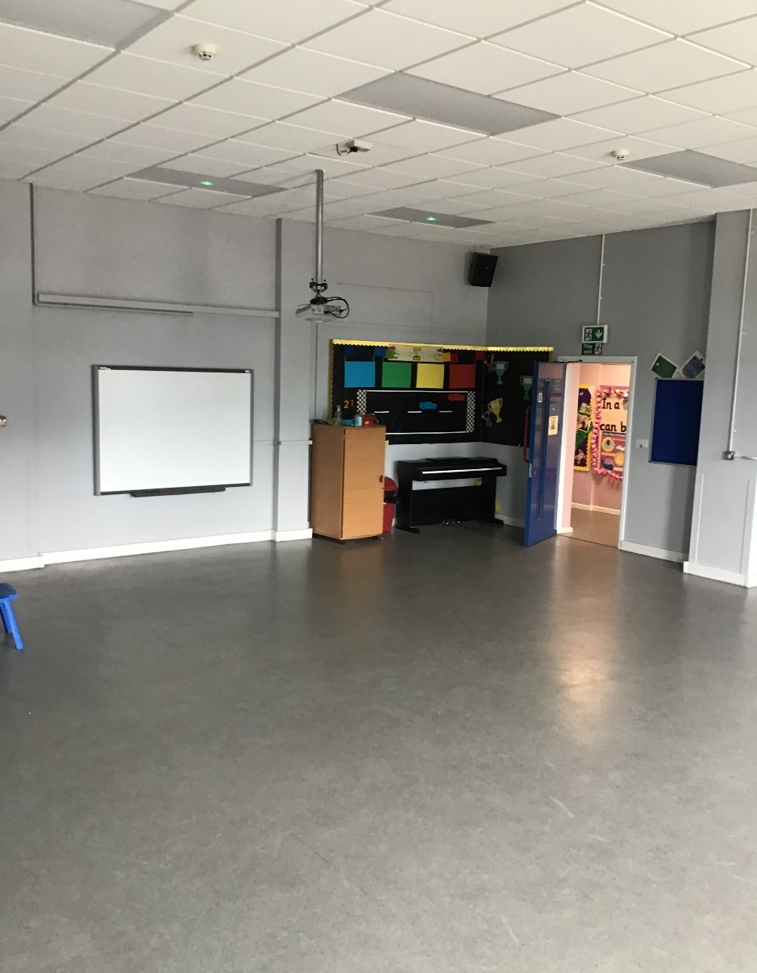
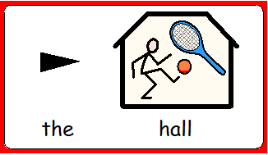
Here is our main reception and the hall. We have our PE sessions in the hall one day per week unless the weather is sunny, then we use our MUGA.

Slide 3
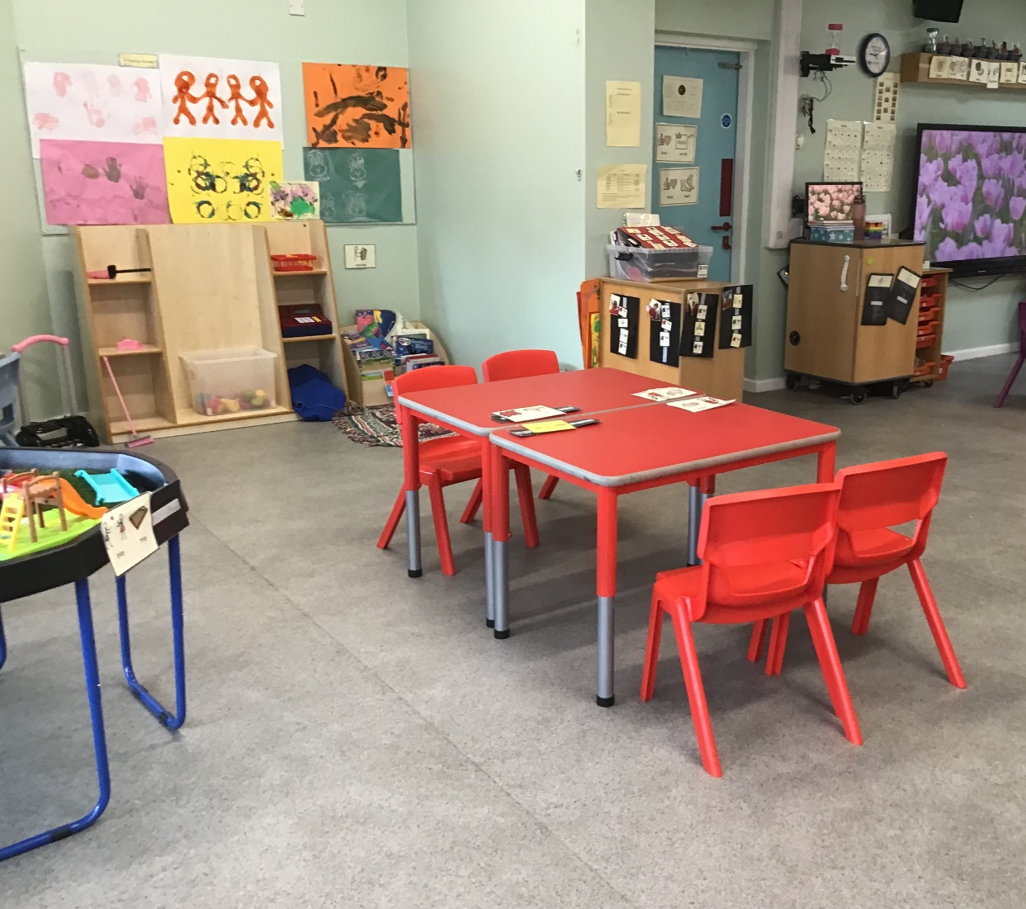
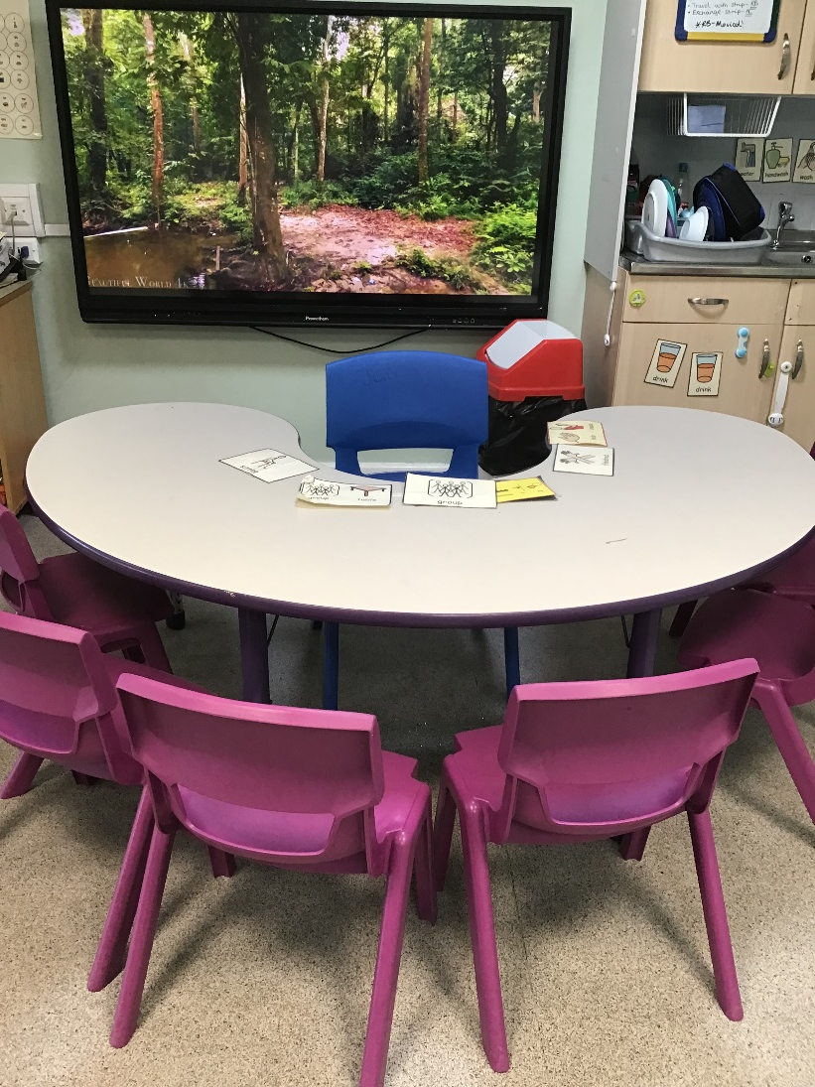
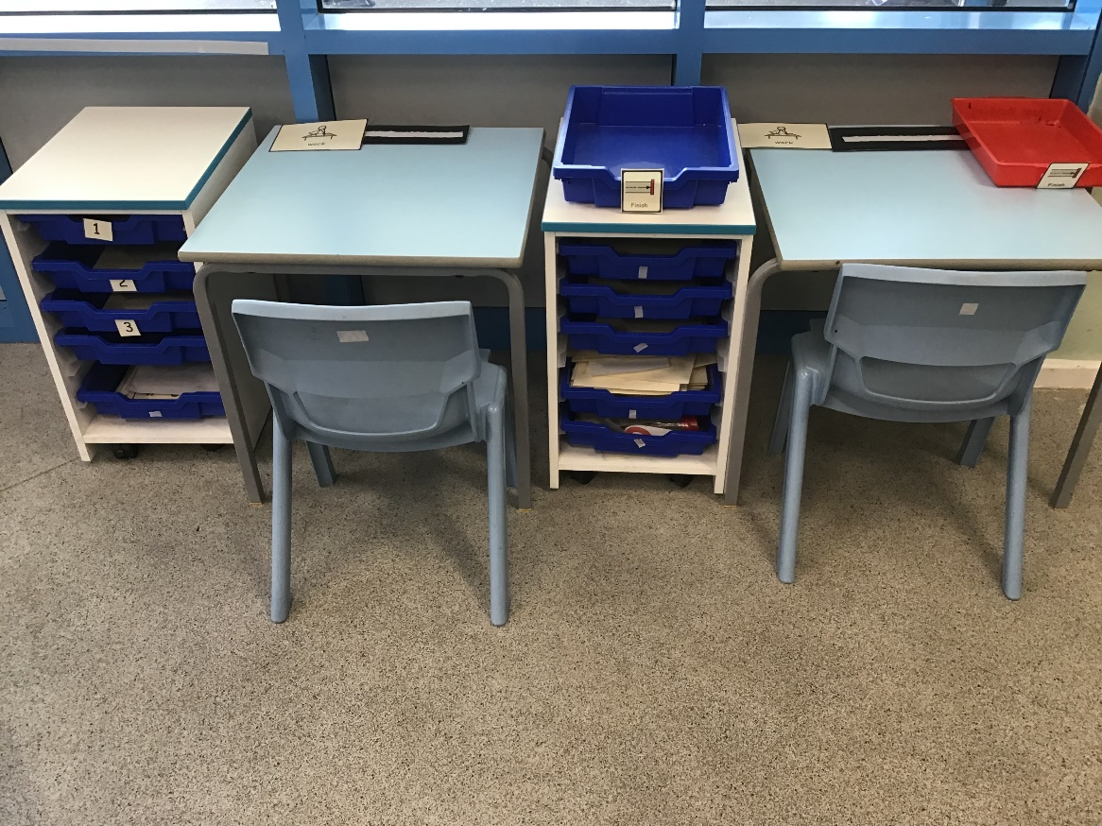
This is Hedgehogs classroom. We have our group table, learning areas and work stations.

Slide 4
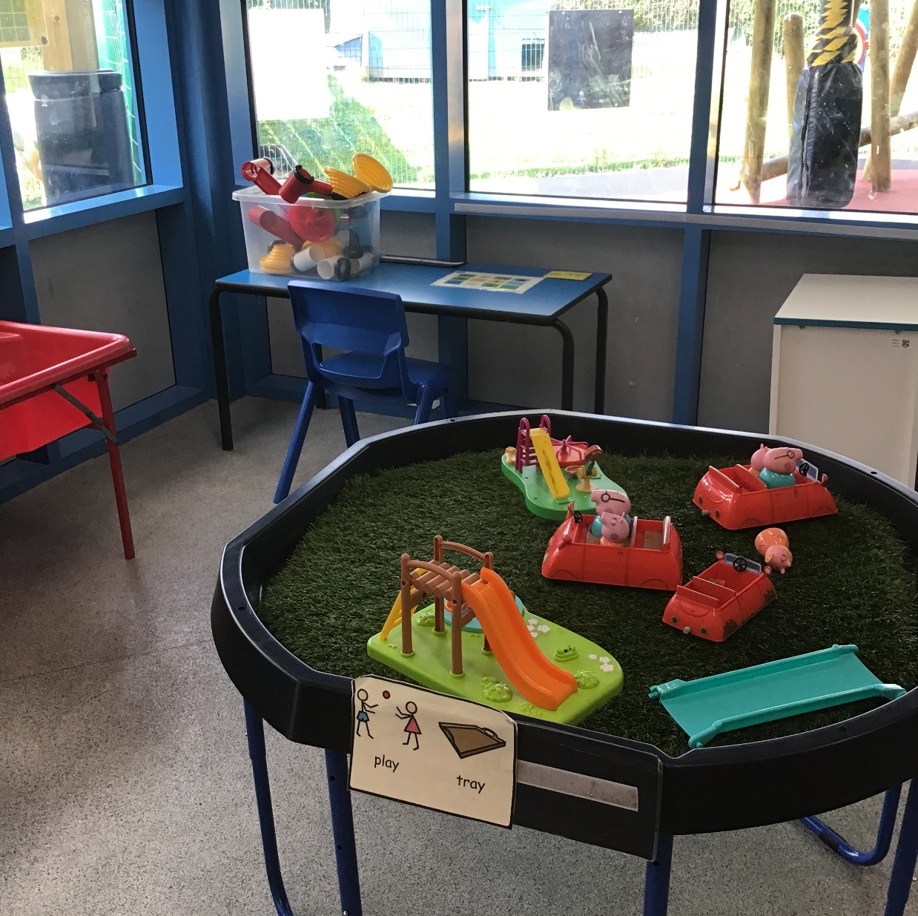
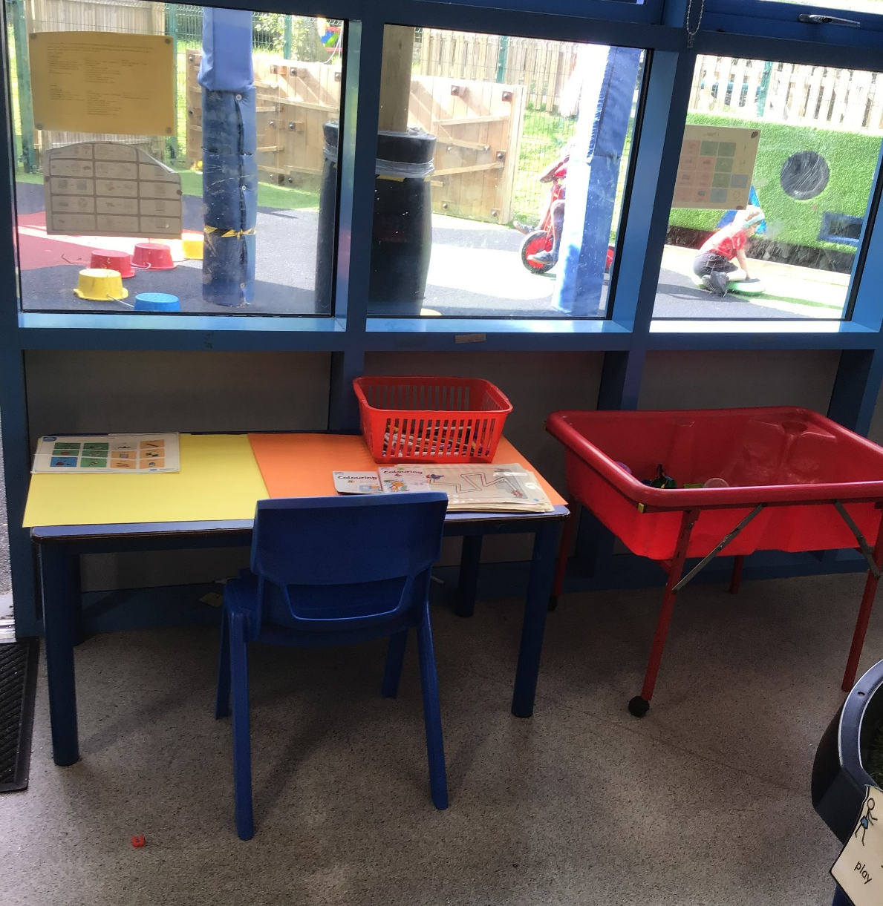
Here is our play tray, construction area and mark making table for our continuous provision.

Slide 5
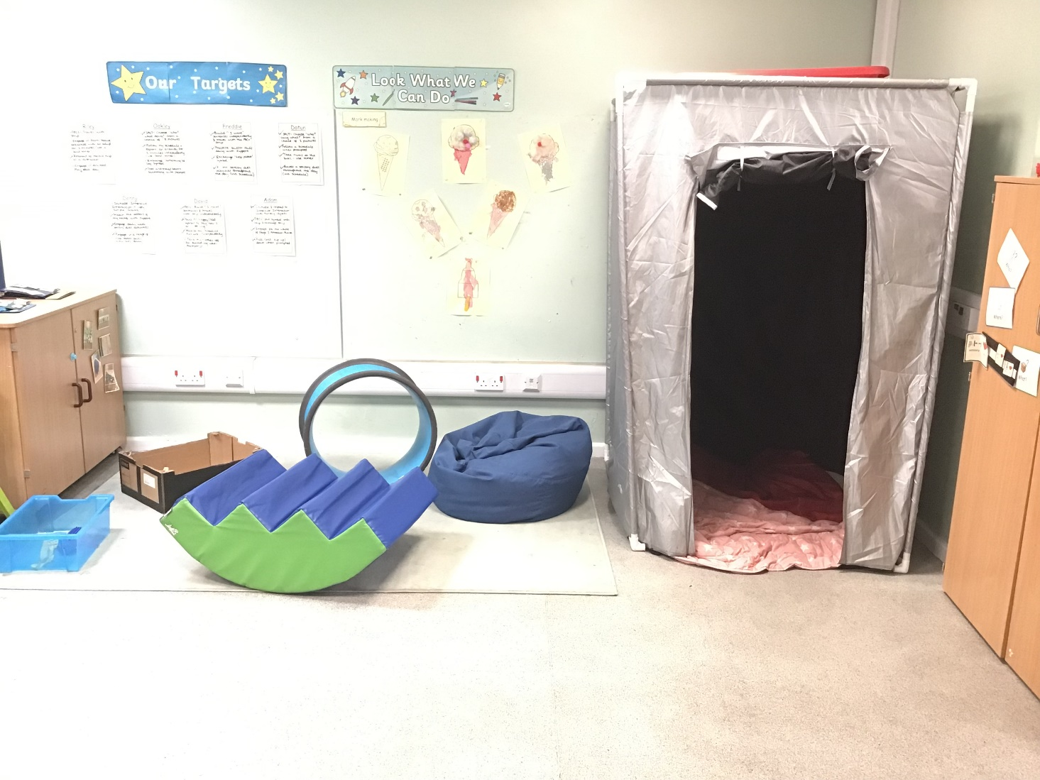
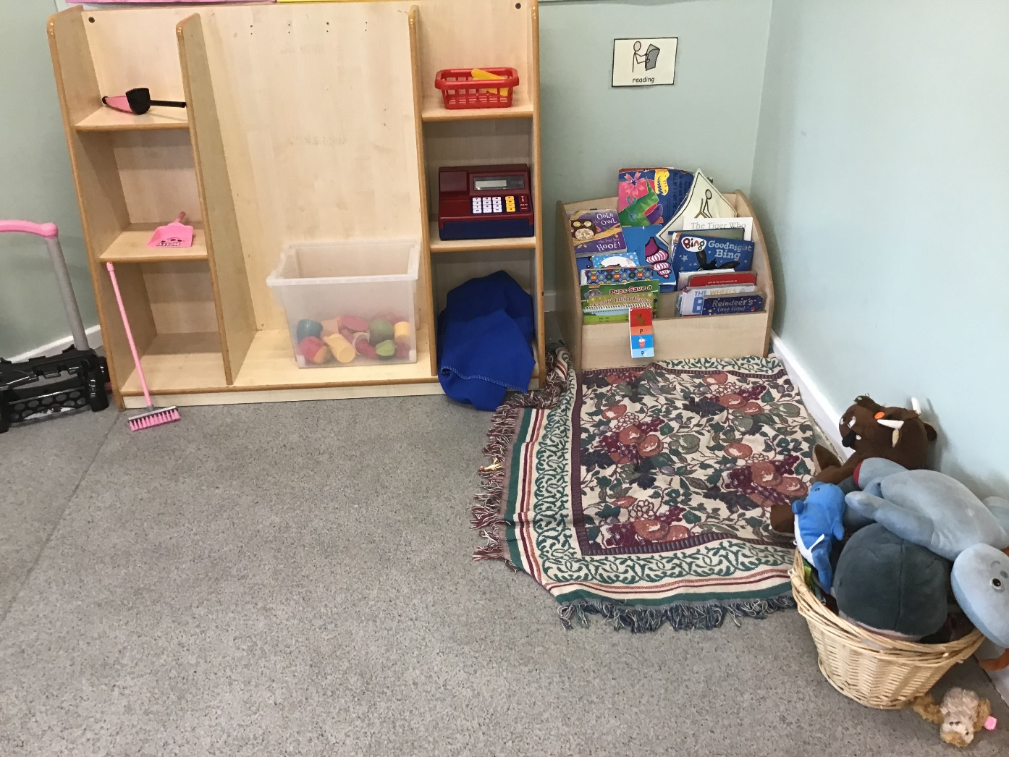
We also have a reading area, role play area and a sensory diet area with a huge tent!

Slide 6
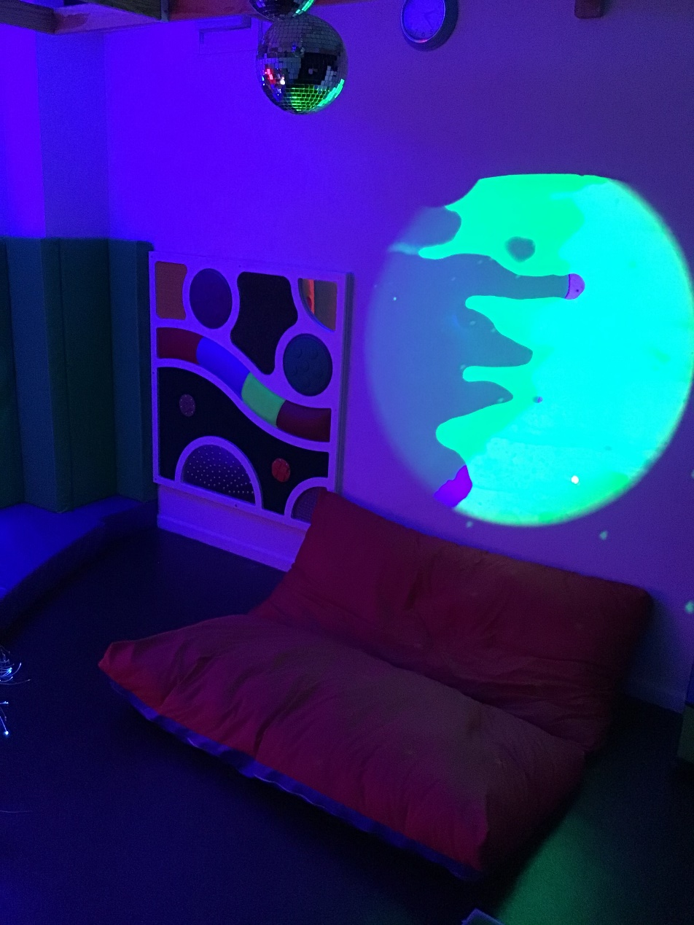
We have an amazing sensory room which we use twice a week!

Slide 7
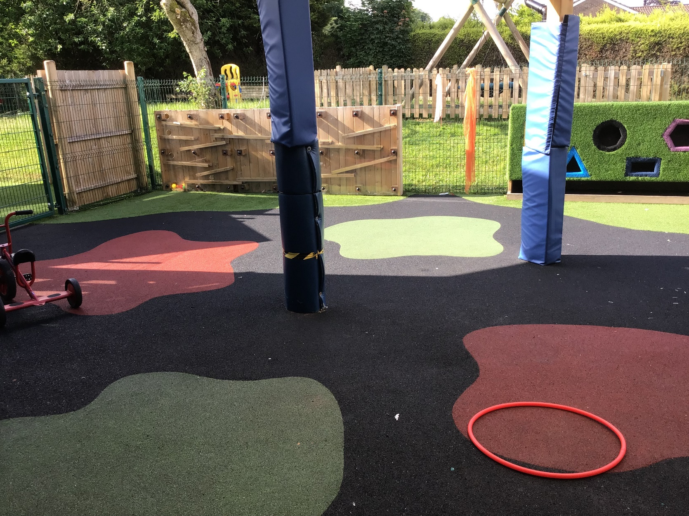
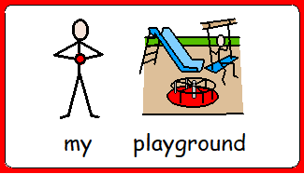
We have our own playground area. We also have access to the bridge area, the swing, the forest school area and the sensory garden.

Slide 8
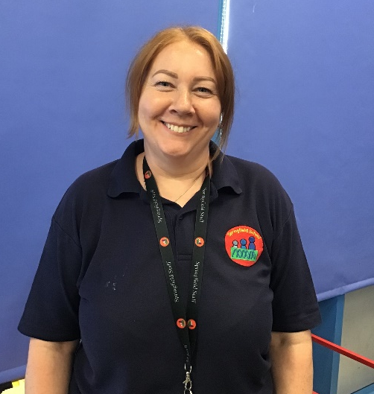
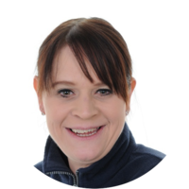
Meet the staff…
In Hedgehogs class, we have one class teacher, 3 teaching assistants:
Class teacher – Demi
Teaching Assistant – Jayne
Teaching assistant – Zoe
Teaching assistant – Michelle (Monday & Tuesday)
Michelle
Zoe
Jayne

Slide 9
Daily timetable…
9-9.30am – Sensory diet, signing in and greeting (name finding / writing), reading
9.30-10.15am – Phonics; Focused lesson with access to structured and unstructured activities within the room/ continuous provision
10.15-11am – Snack time, play time and toileting
11-11.40am – Focussed lesson (group time and 1:1 activities) with access to structured and unstructured activities within the room. Food play from 11.40-11.50am.
11.50-12pm – Group time. 12-1.30pm – Lunch time and play time, toileting.
1.30-2.15pm – Focussed lesson with access to structured and unstructured activities within the room.
2.15pm – Snack time, playtime, toileting.
2.30-3pm – Focussed lesson with access to structured and unstructured activities within the room.
3pm – End of the day
*Focused lessons will be English, Maths, Phonics, Key Skills/ Interventions, PSHE, RE, Science, PE and Swimming, Art and Design, Design and Technology, Computing, Geography, History, and Music.

Slide 10
Extra information…
We have PE once a week, so please send your child to school wearing their PE kit (Thursdays). PE kit: jogging bottoms/ shorts (weather permitting), white t-shirt, and trainers/ pumps.
We have swimming once a week at our school pool, so please send your child to school with swimwear, a swim nappy and a towel (Tuesdays).
Please send in enough nappies/ wipes for the week – I will email you when your child is running low on these.
Please send in enough snacks each day or at the start of the week. We have snack twice a day and encourage children to choose using their preferred method of communication.
Please send in a water bottle to keep in school for your child to use each day. If your child drinks juice, please send in a bottle of juice and I will email you when we need more sending in.
Children in KS1 receive free school meals, so if you would like us to order a meal or a taster plate for your child, then please let us know their choices from the lunch menu that is sent home each week. Once we get to know your child, we can support them to choose what they like to eat.

Slide 11
Extra information…
A spare change of clothes is a good idea to keep in school, as well as sending in sun cream on hot days, and a warm-waterproof coat during the winter.
We make the most of being outside in all weather and we also have Forest School sessions too, so please send in some waterproofs and wellies that we can keep in school for your child.
Reading books will be sent home each day and changed weekly. It is really important to share books with your child, encouraging them to feel the pages/ lift the flaps/ pull the tabs etc.
The school day starts at 8.55am and finishes at 3.15pm. If your child is accessing transport, please be assured that a member of staff will collect them and walk them safely into school.
If you have any questions at all, please email me at hedgehogs@springfield.staffs.sch.uk (Demi) or contact the office - 01538 383558.
Thank you! We are looking forward to our new Hedgehogs class in September! ☺

